Slide 1


Titolo presentazione sottotitolo
Introduzione all’Analisi di Missioni Spaziali: Prova Finale
Milano, XX mese 20XX

Slide 2
Gruppo: B35
Massavelli Stefano 10750786 980878
Molteni Andrea 10766121 981716
Novellini Lorenzo 10796033 982619

Slide 3
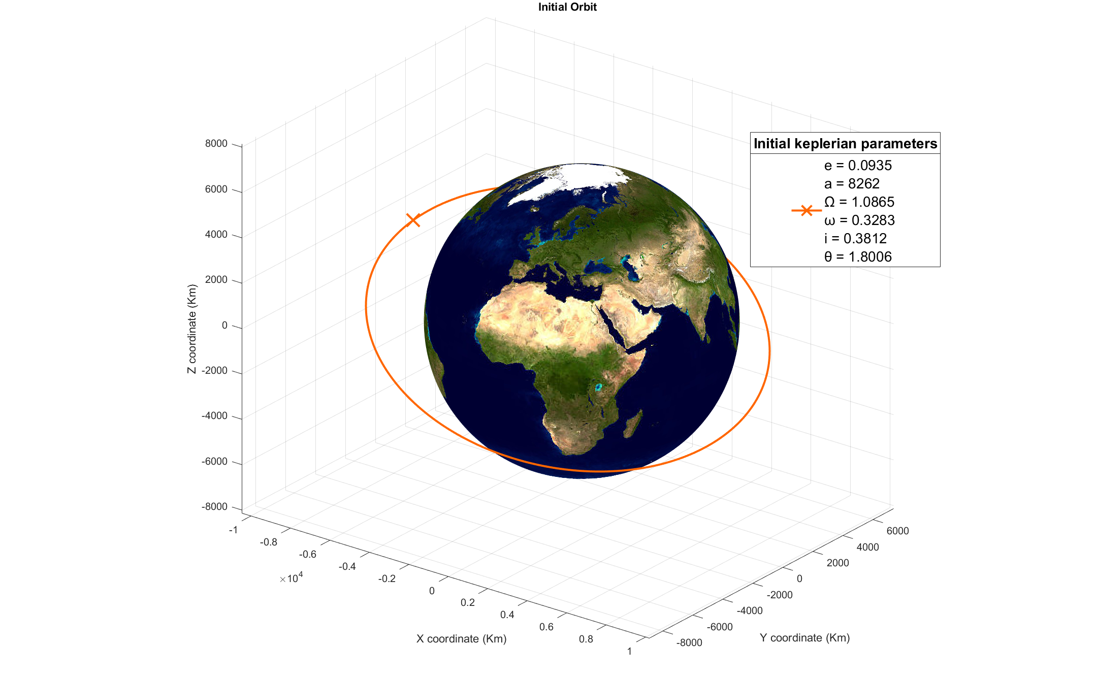
Initial orbit characterization

Slide 4
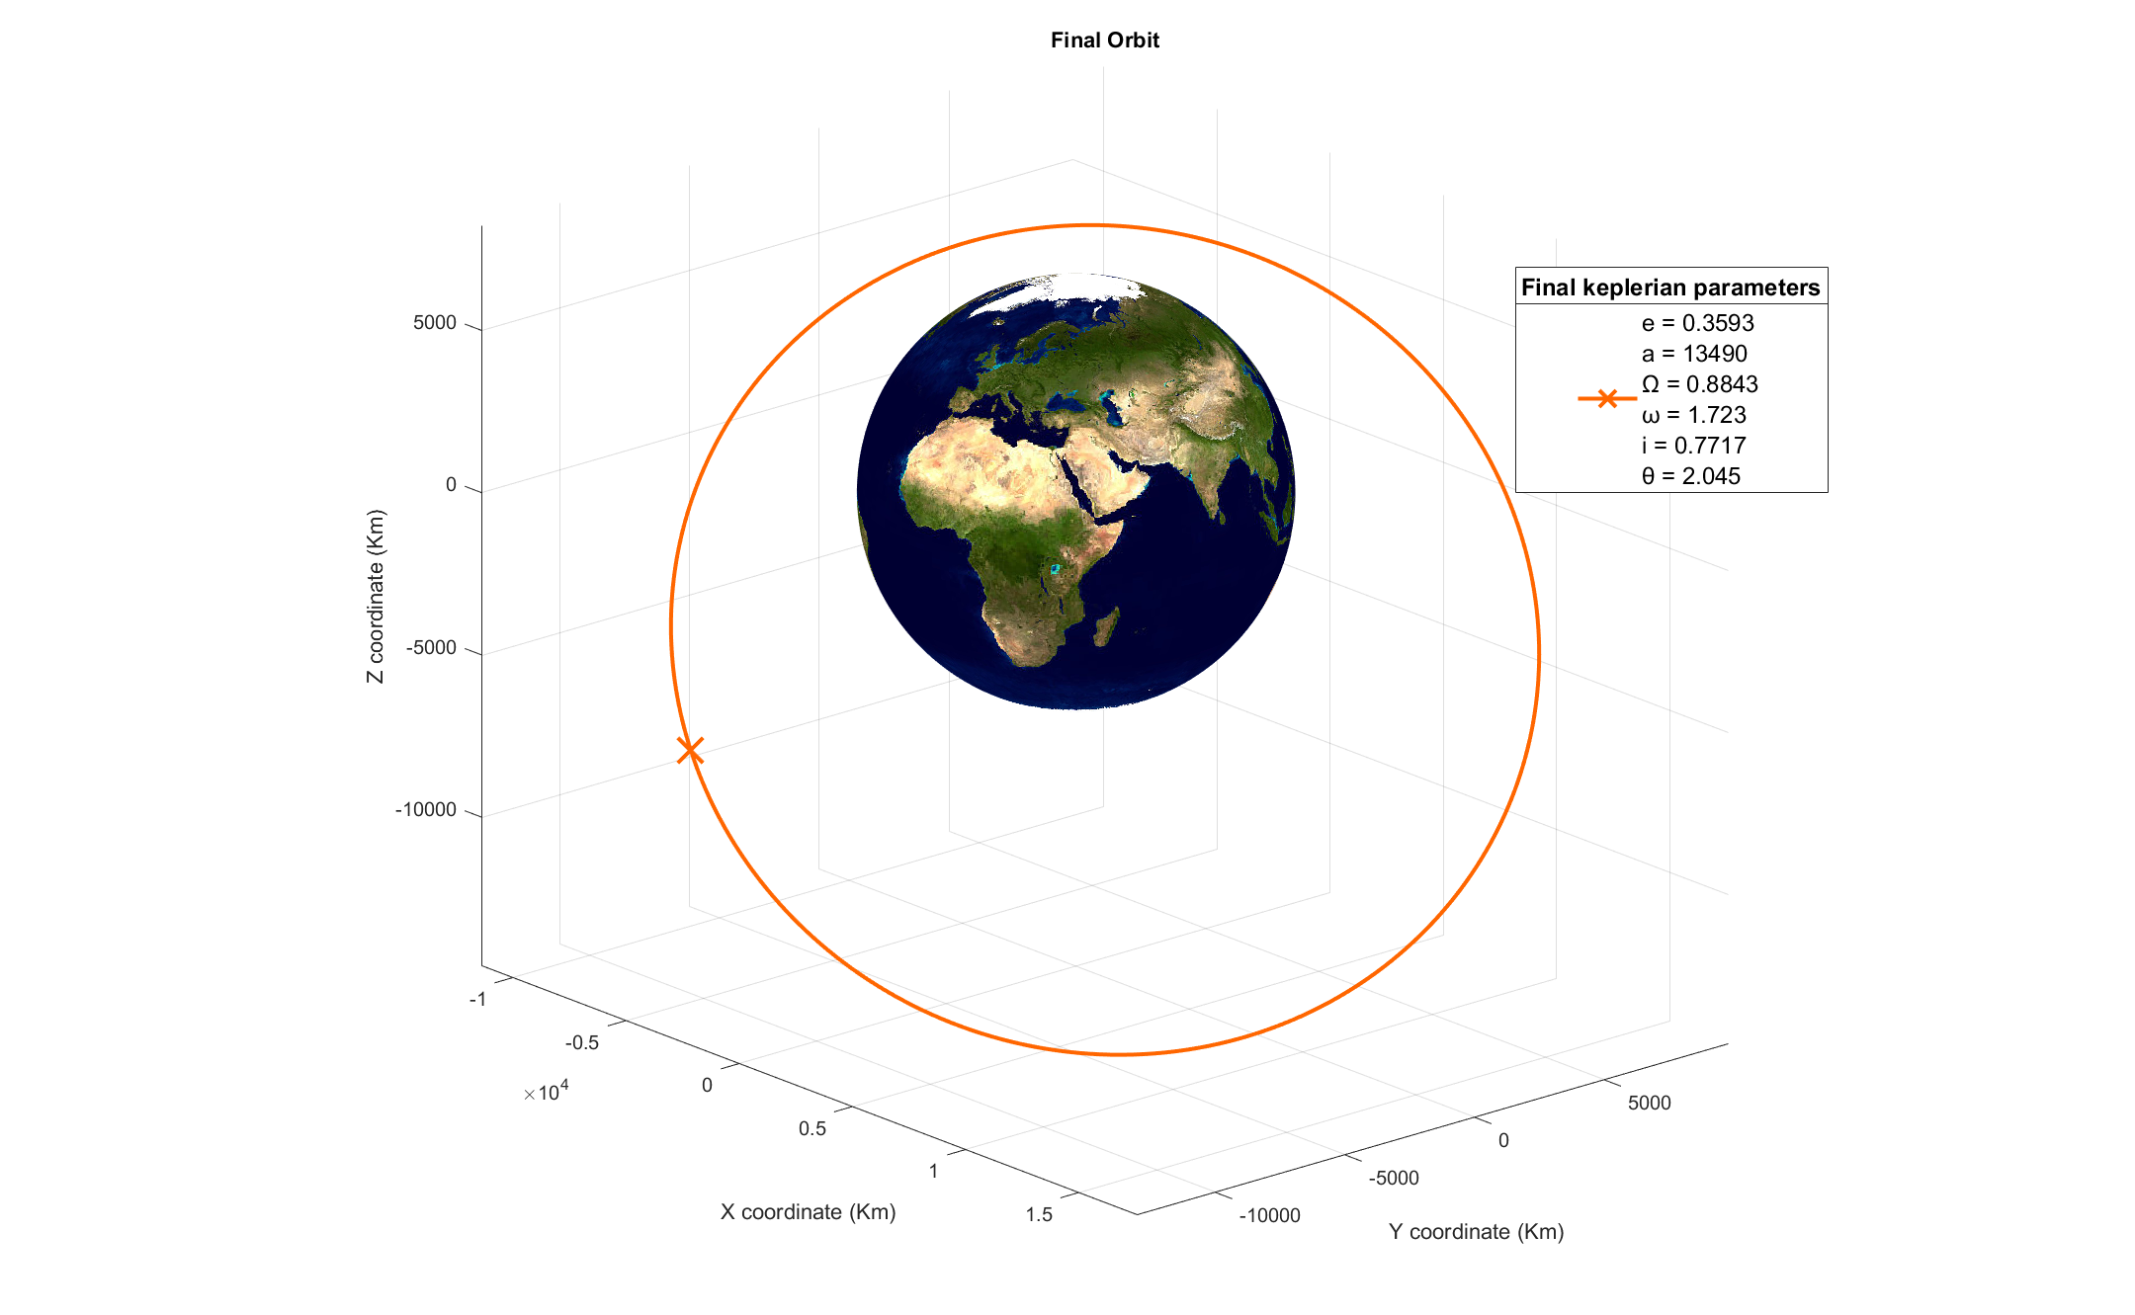
Final orbit characterization

Slide 5
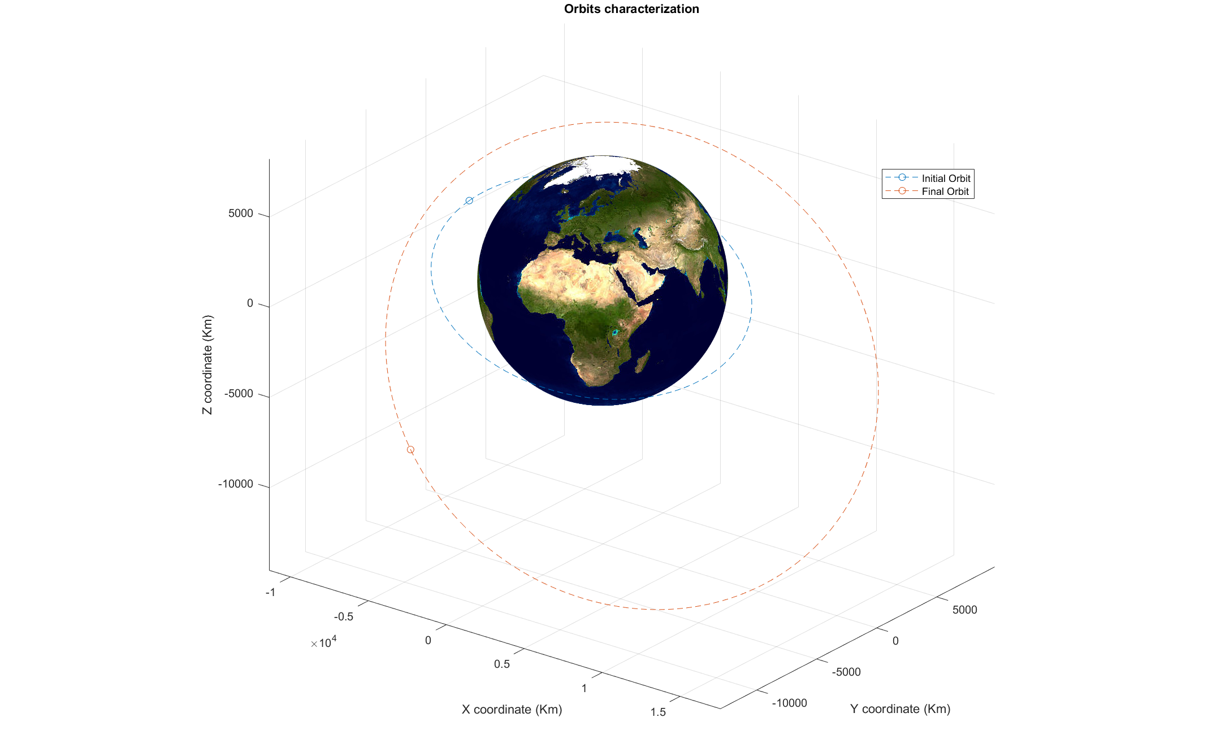
Preliminary Analysis
Looking at the α between initial and final orbit we can conclude that a bi-elliptic plane change might be an inefficient strategy ( ∥α∥ = 23.1539◦ < 38.94◦ ) thus we will stick to standard maneuvers and variations of it.

Slide 6
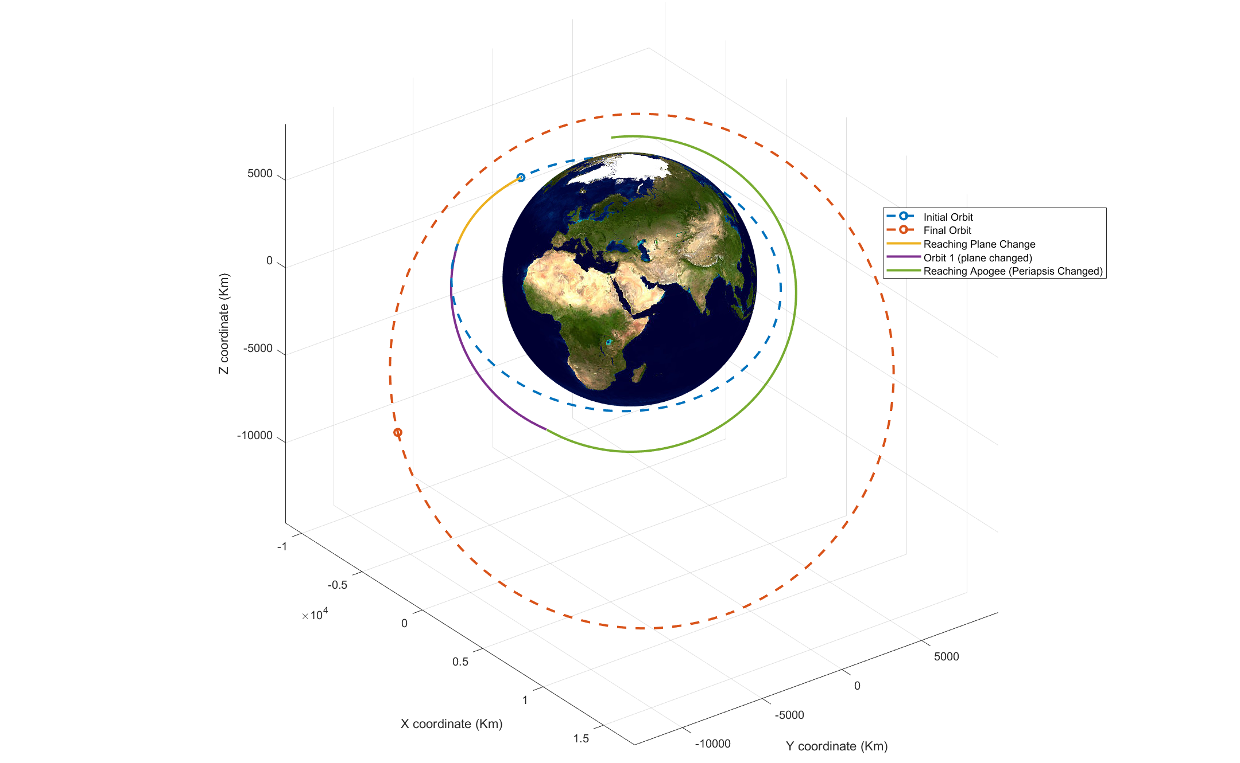
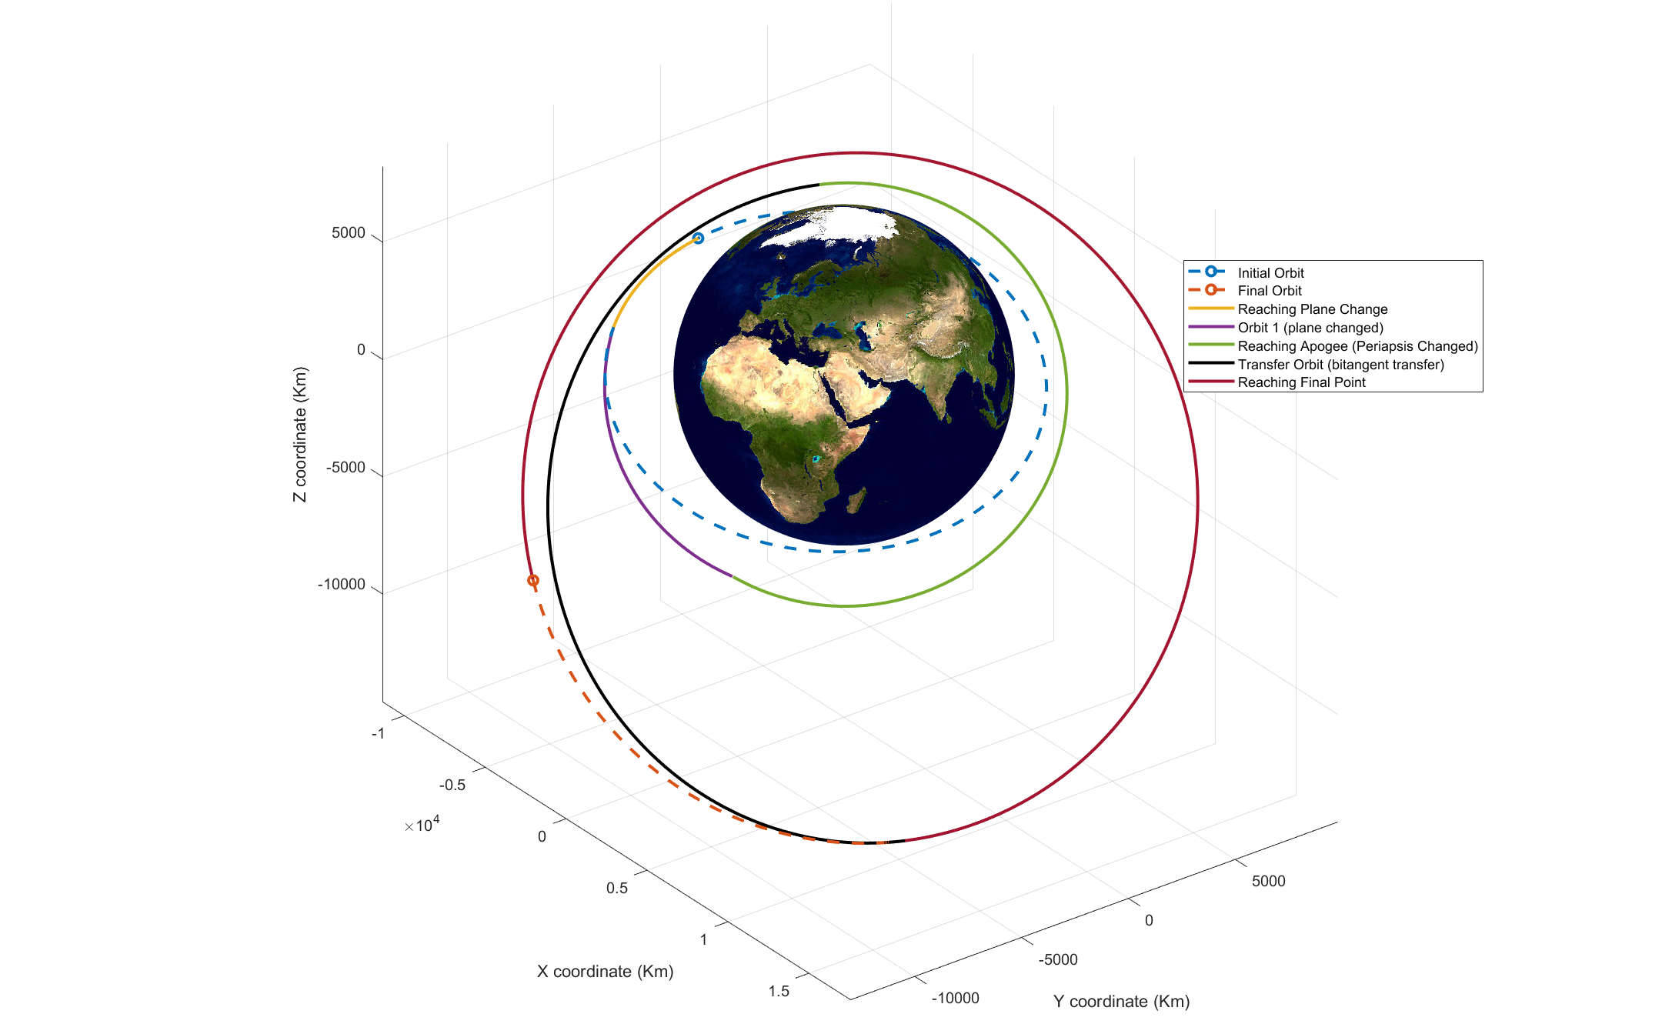
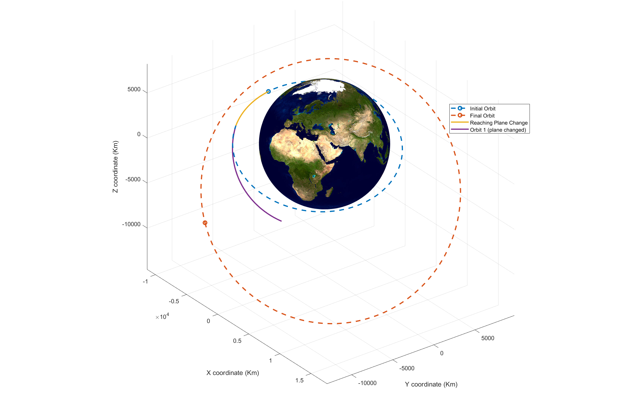
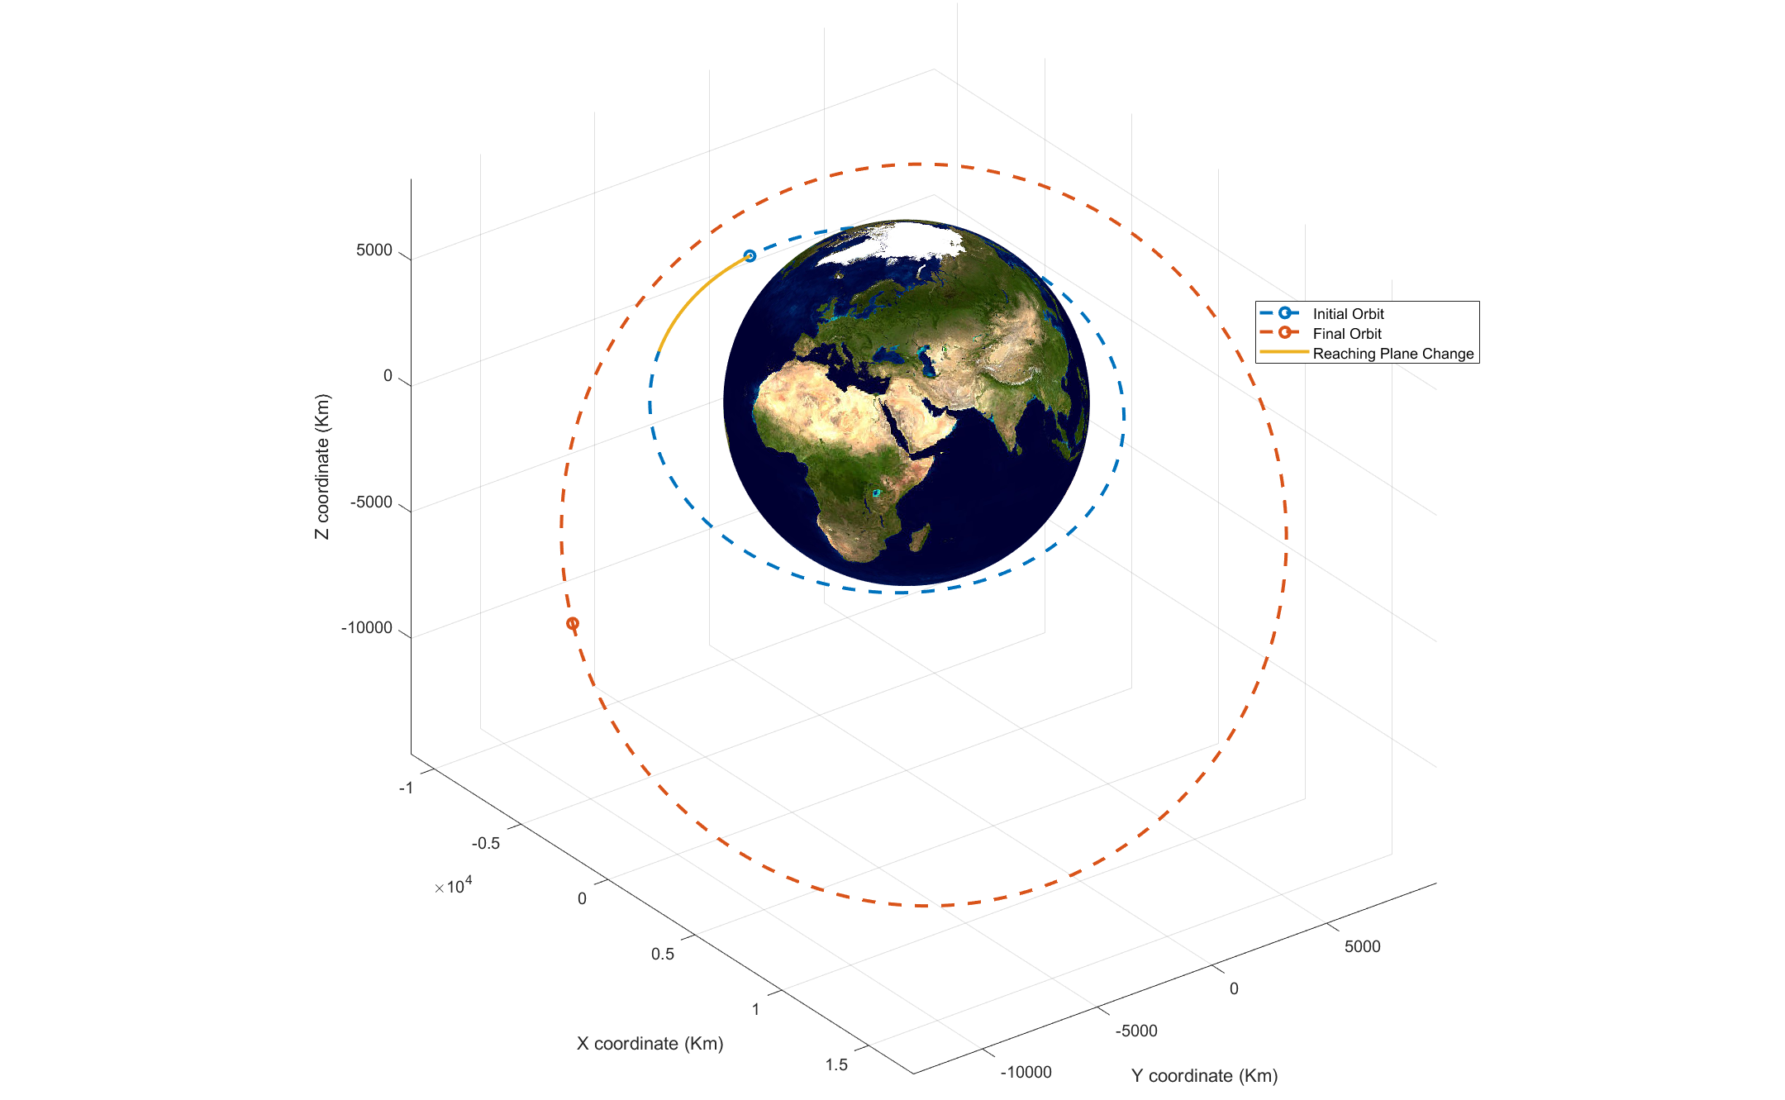
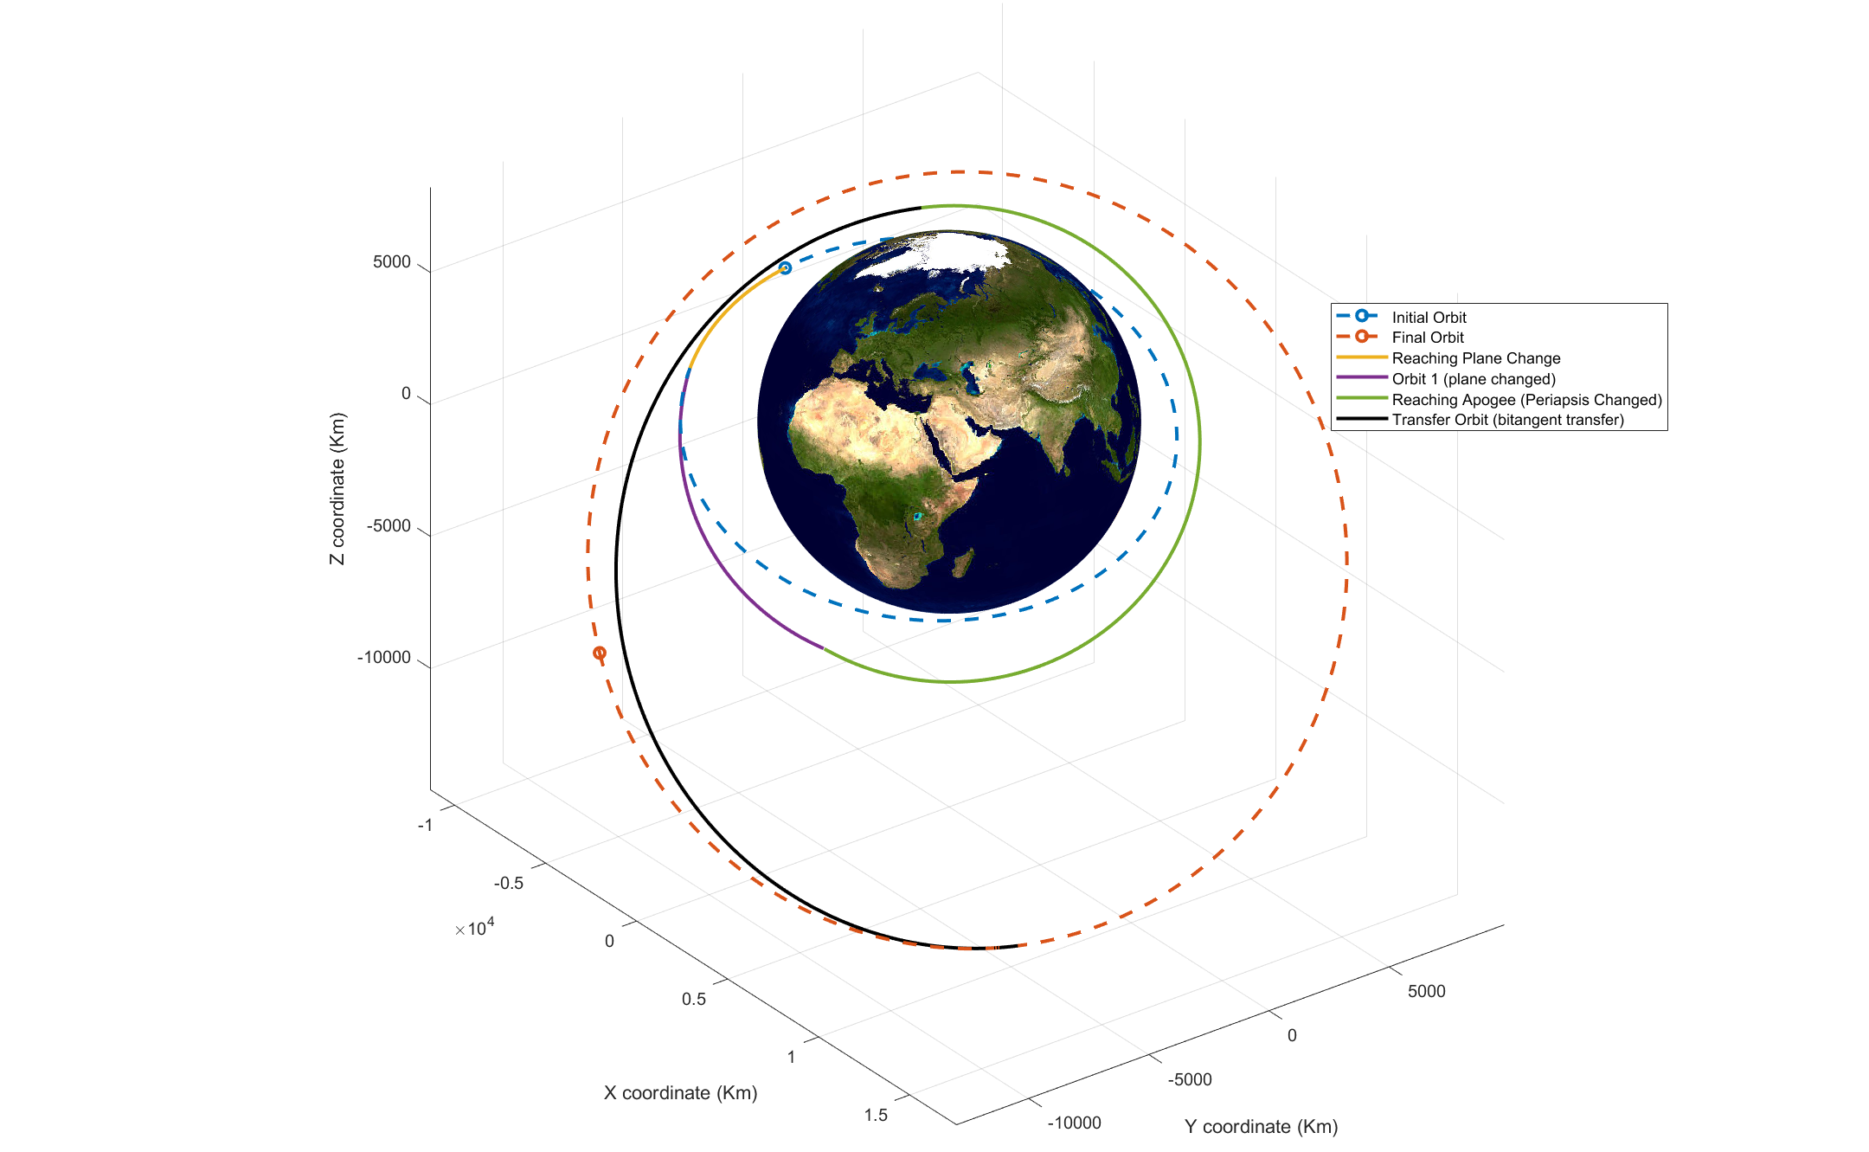
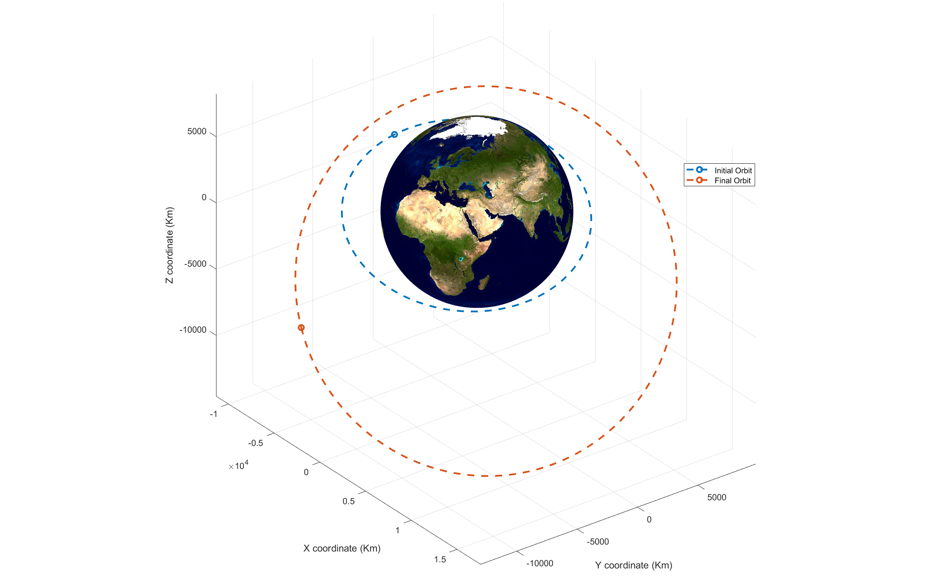
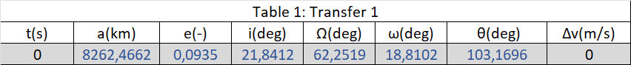
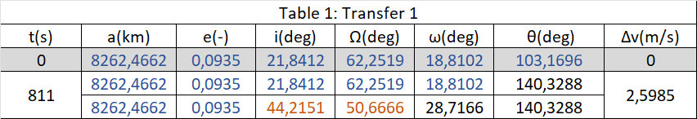
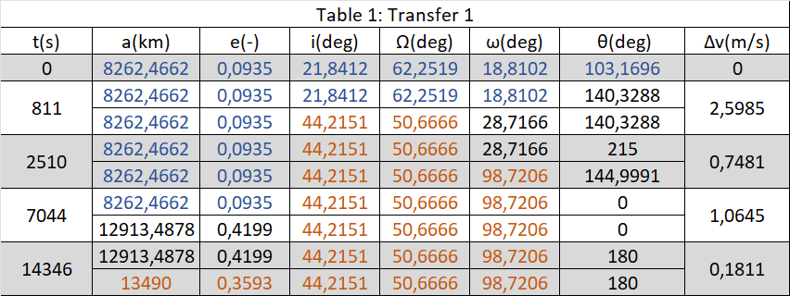
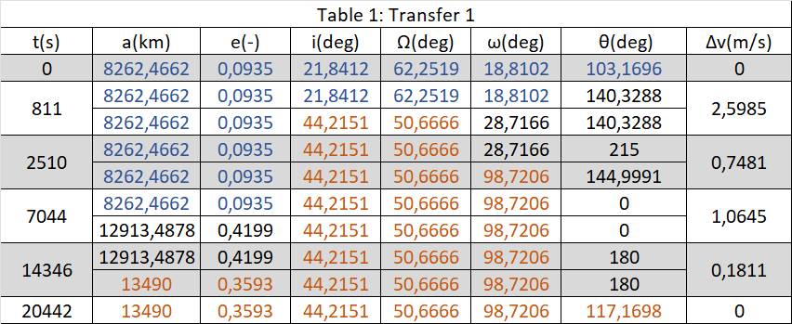
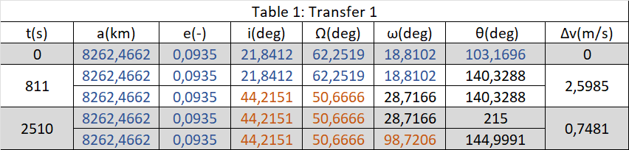
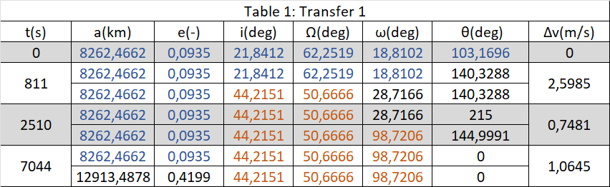
Standard transfer

Slide 7
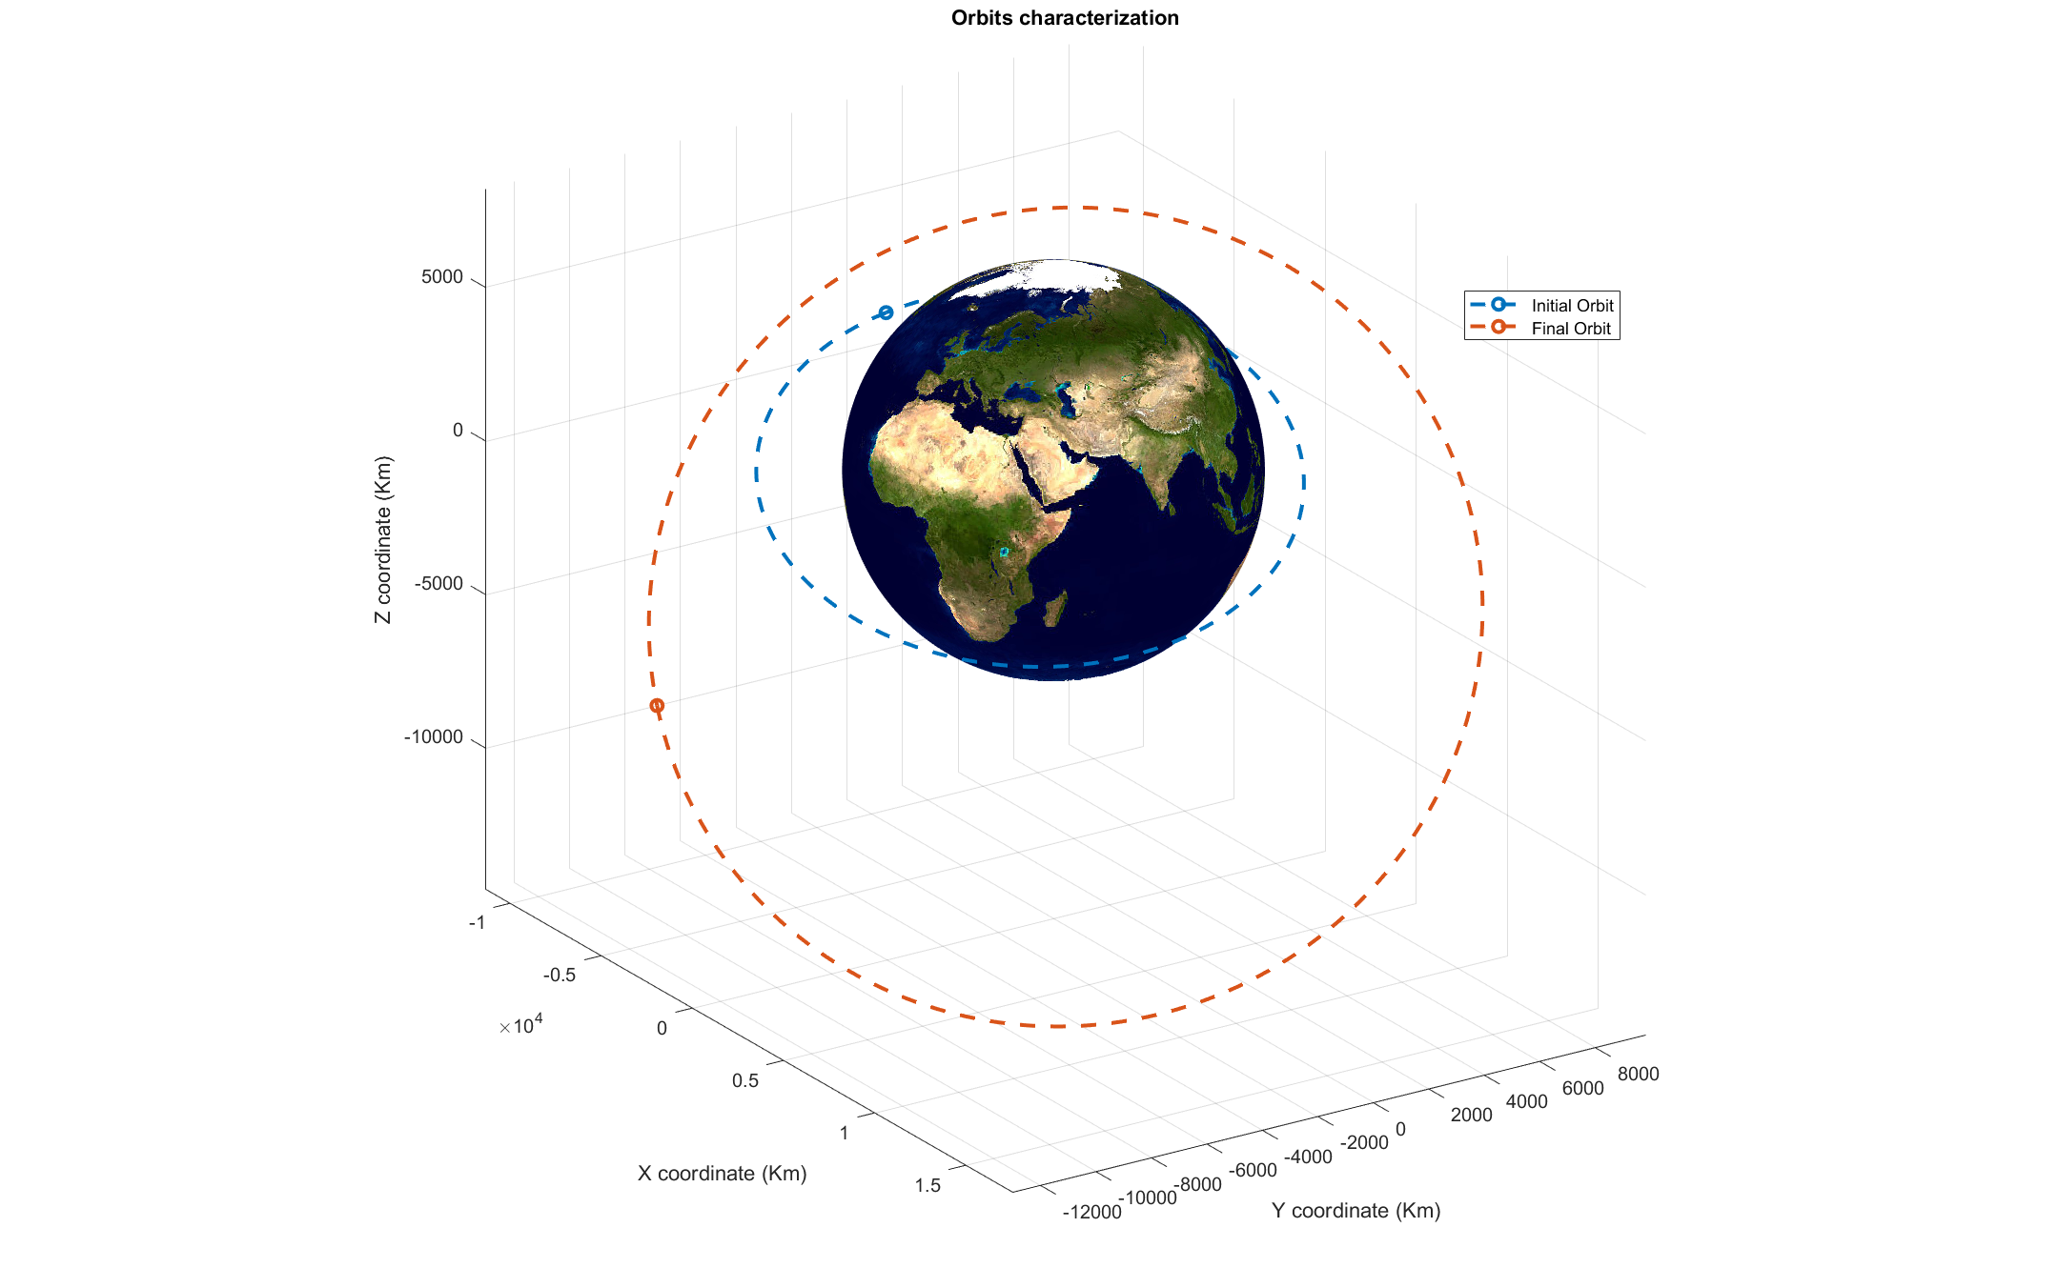
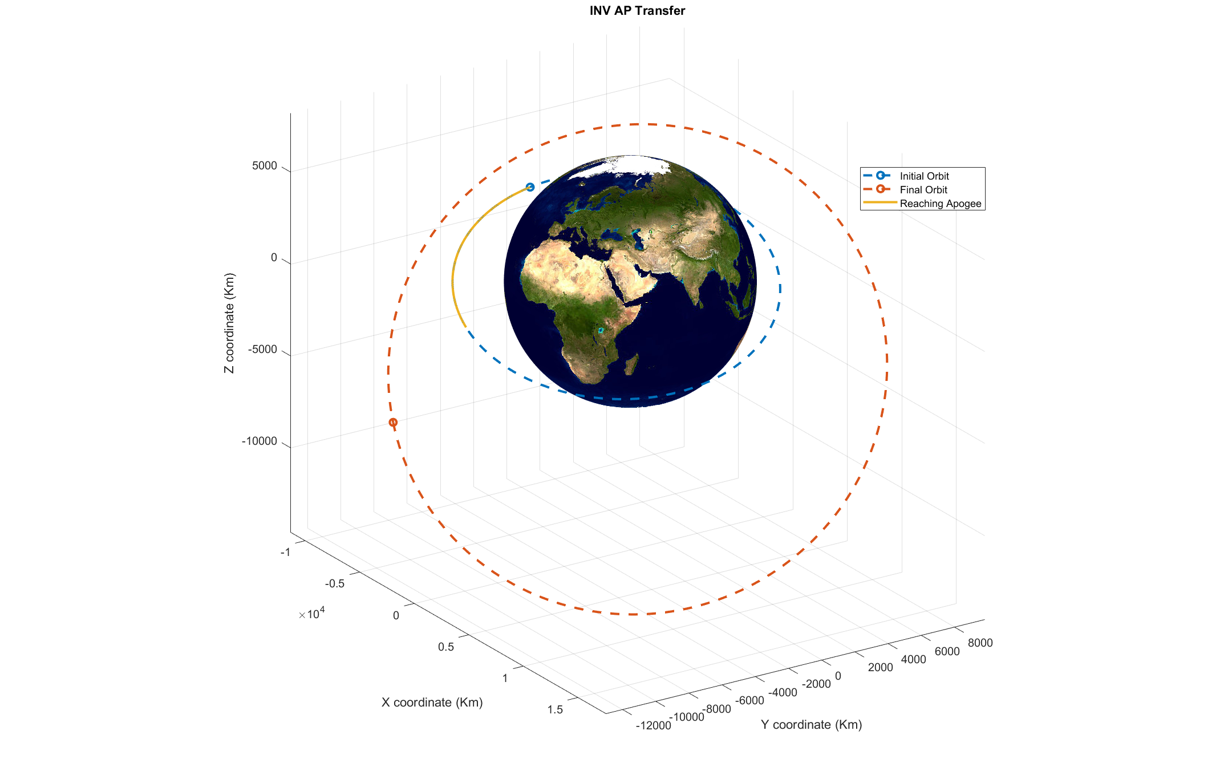
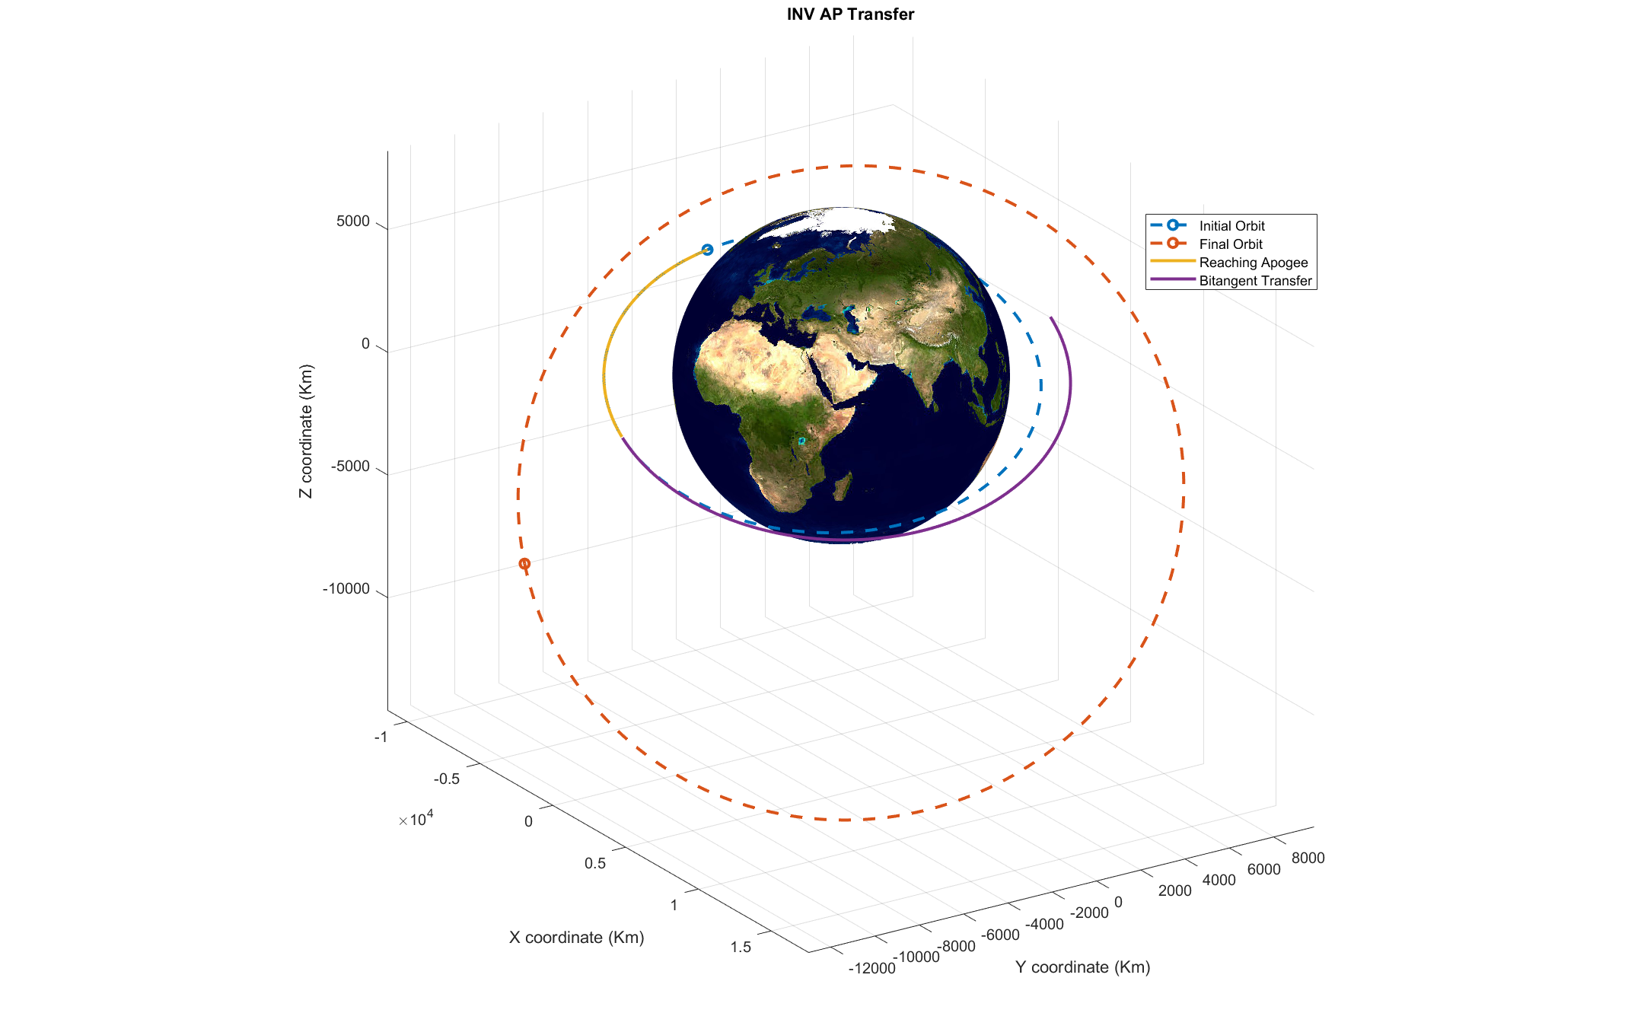
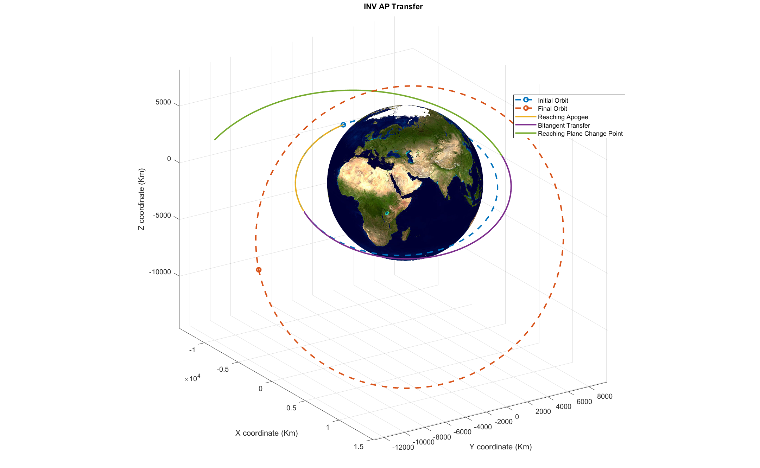
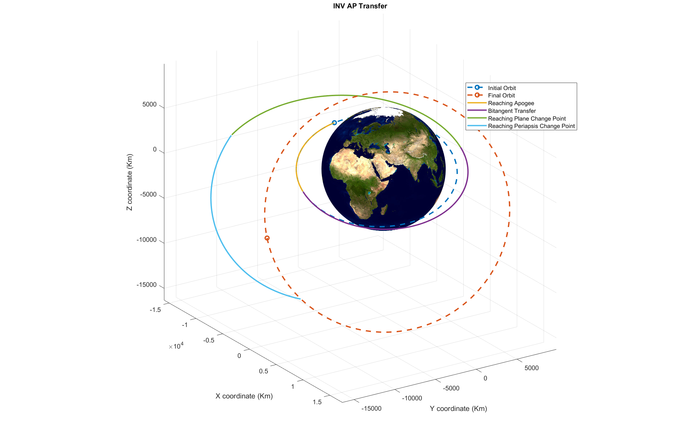
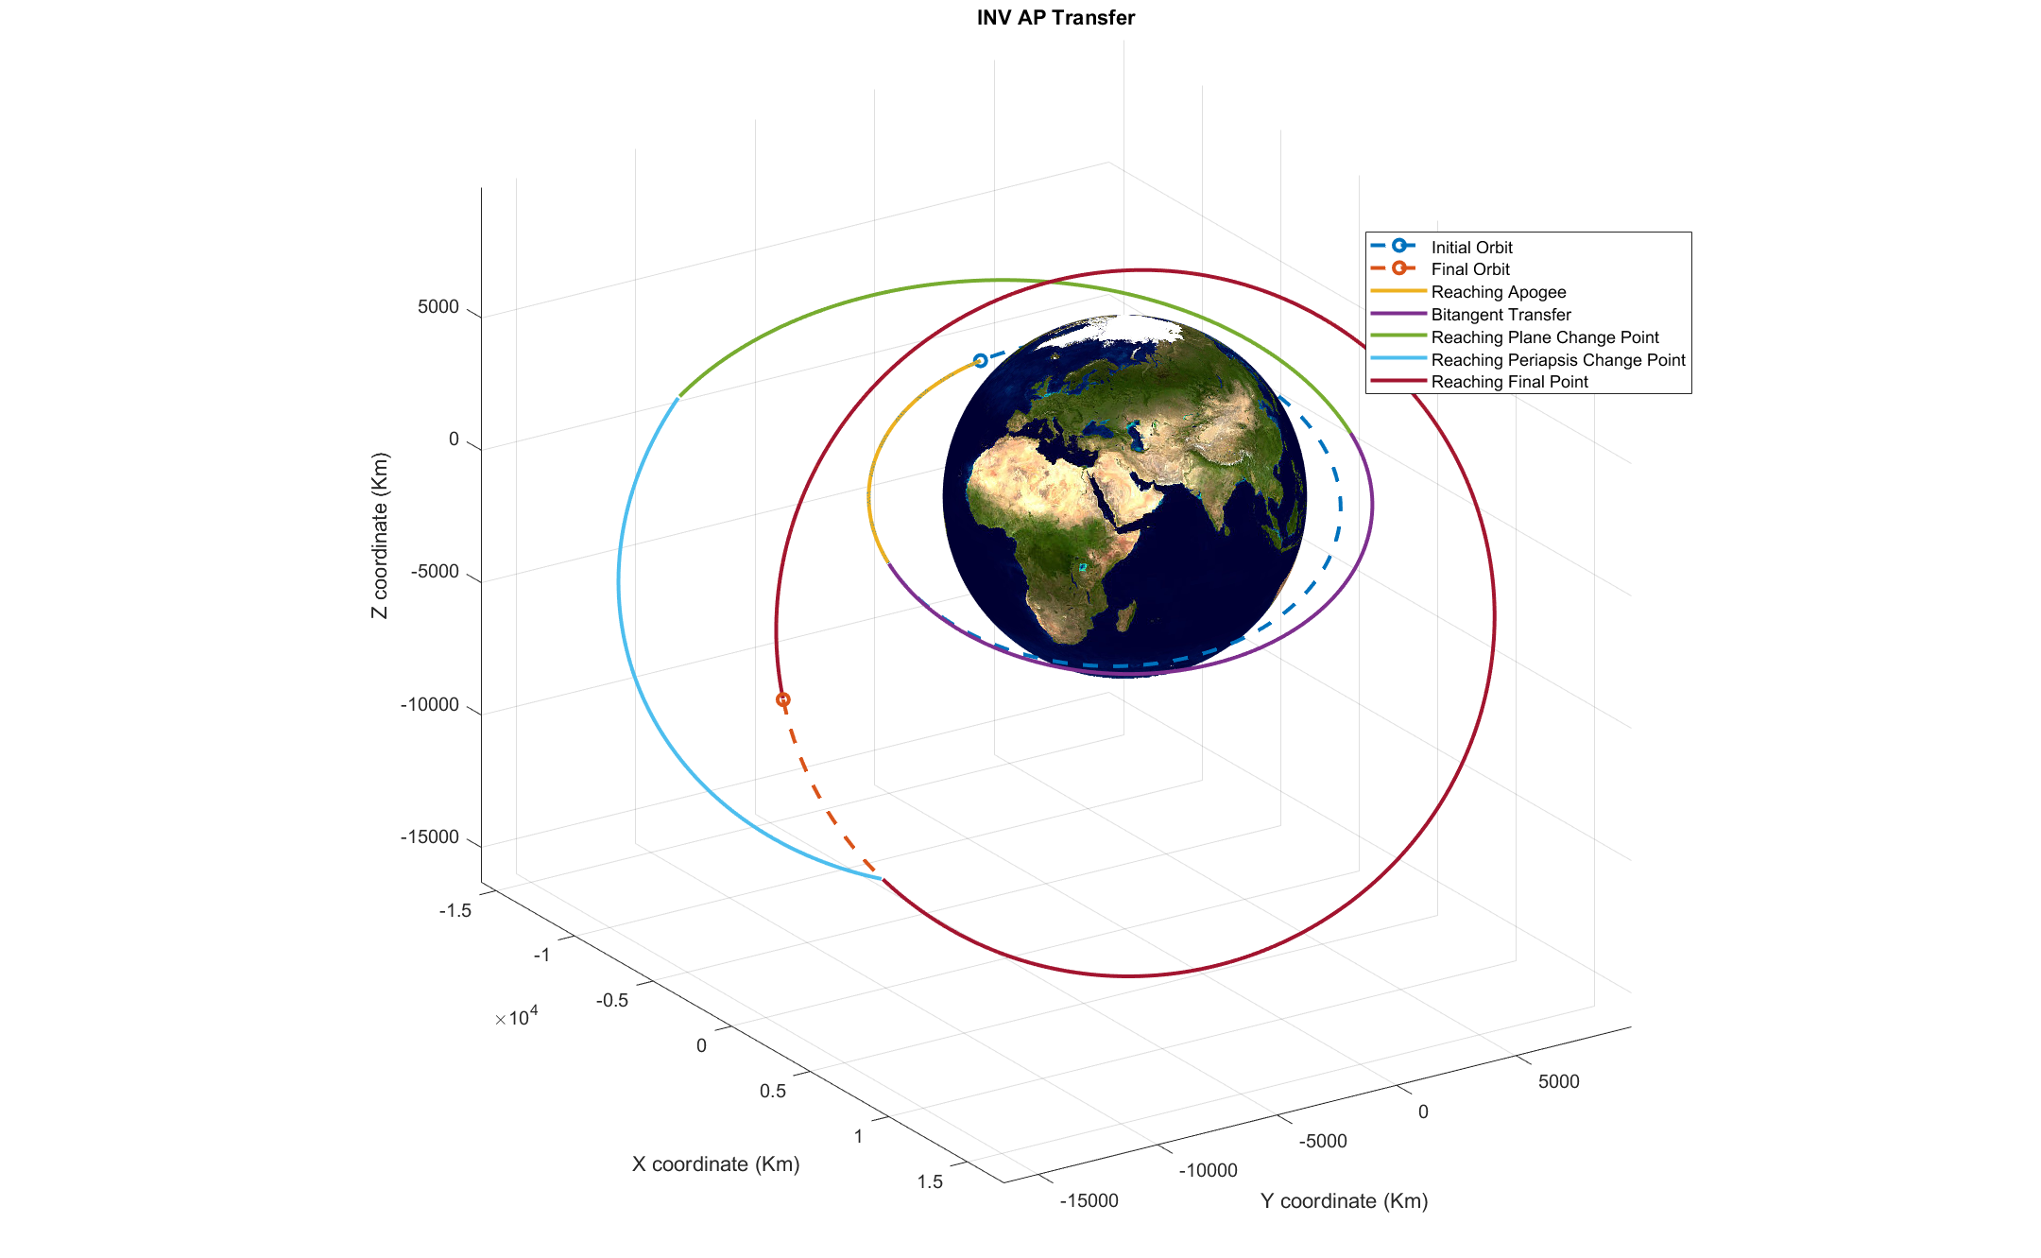
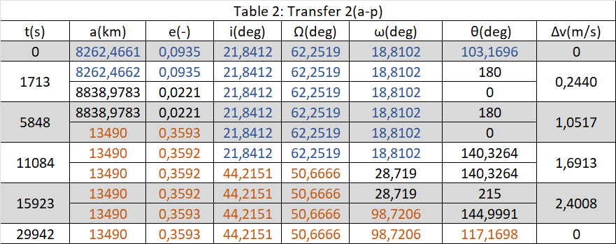
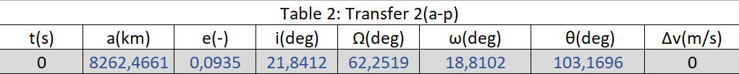
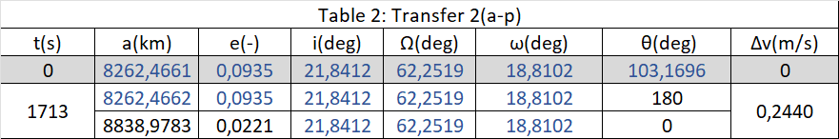
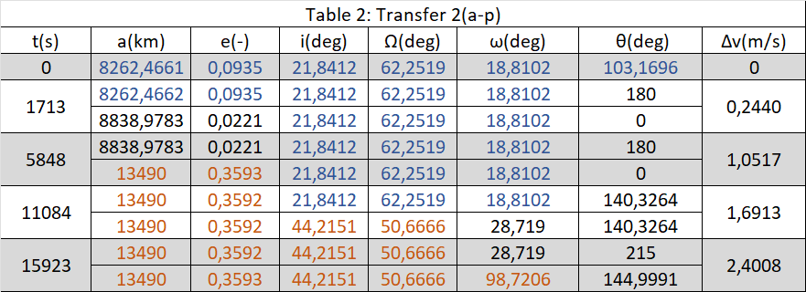
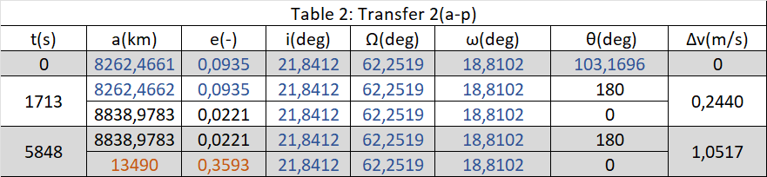
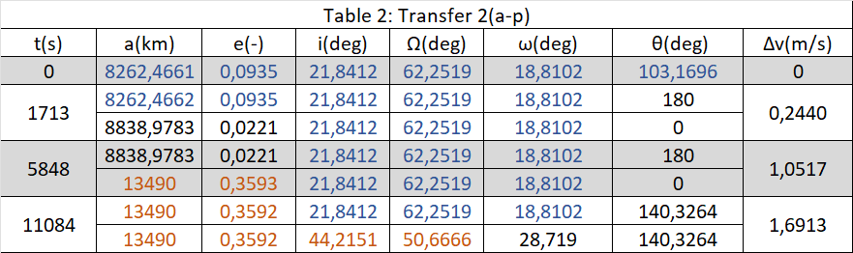
‘Inverse’ strategy: apogee-perigee transfer
We aren’t satisfied with the cost of the first maneuver so we try an «inverse» strategy where we operate the plane change at a further distant

Slide 8
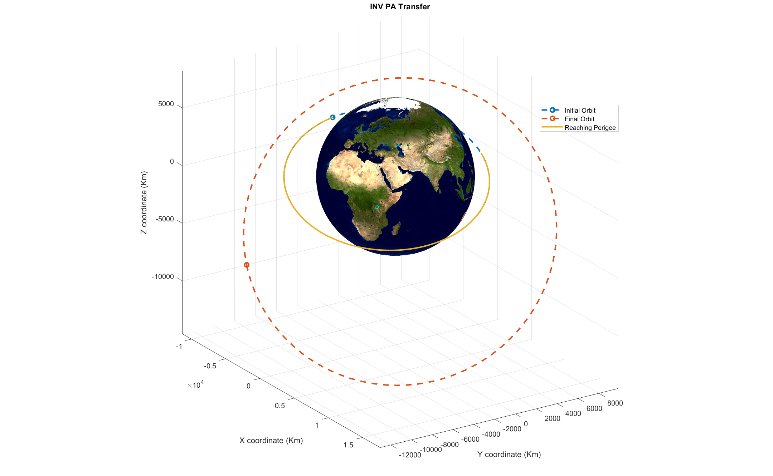
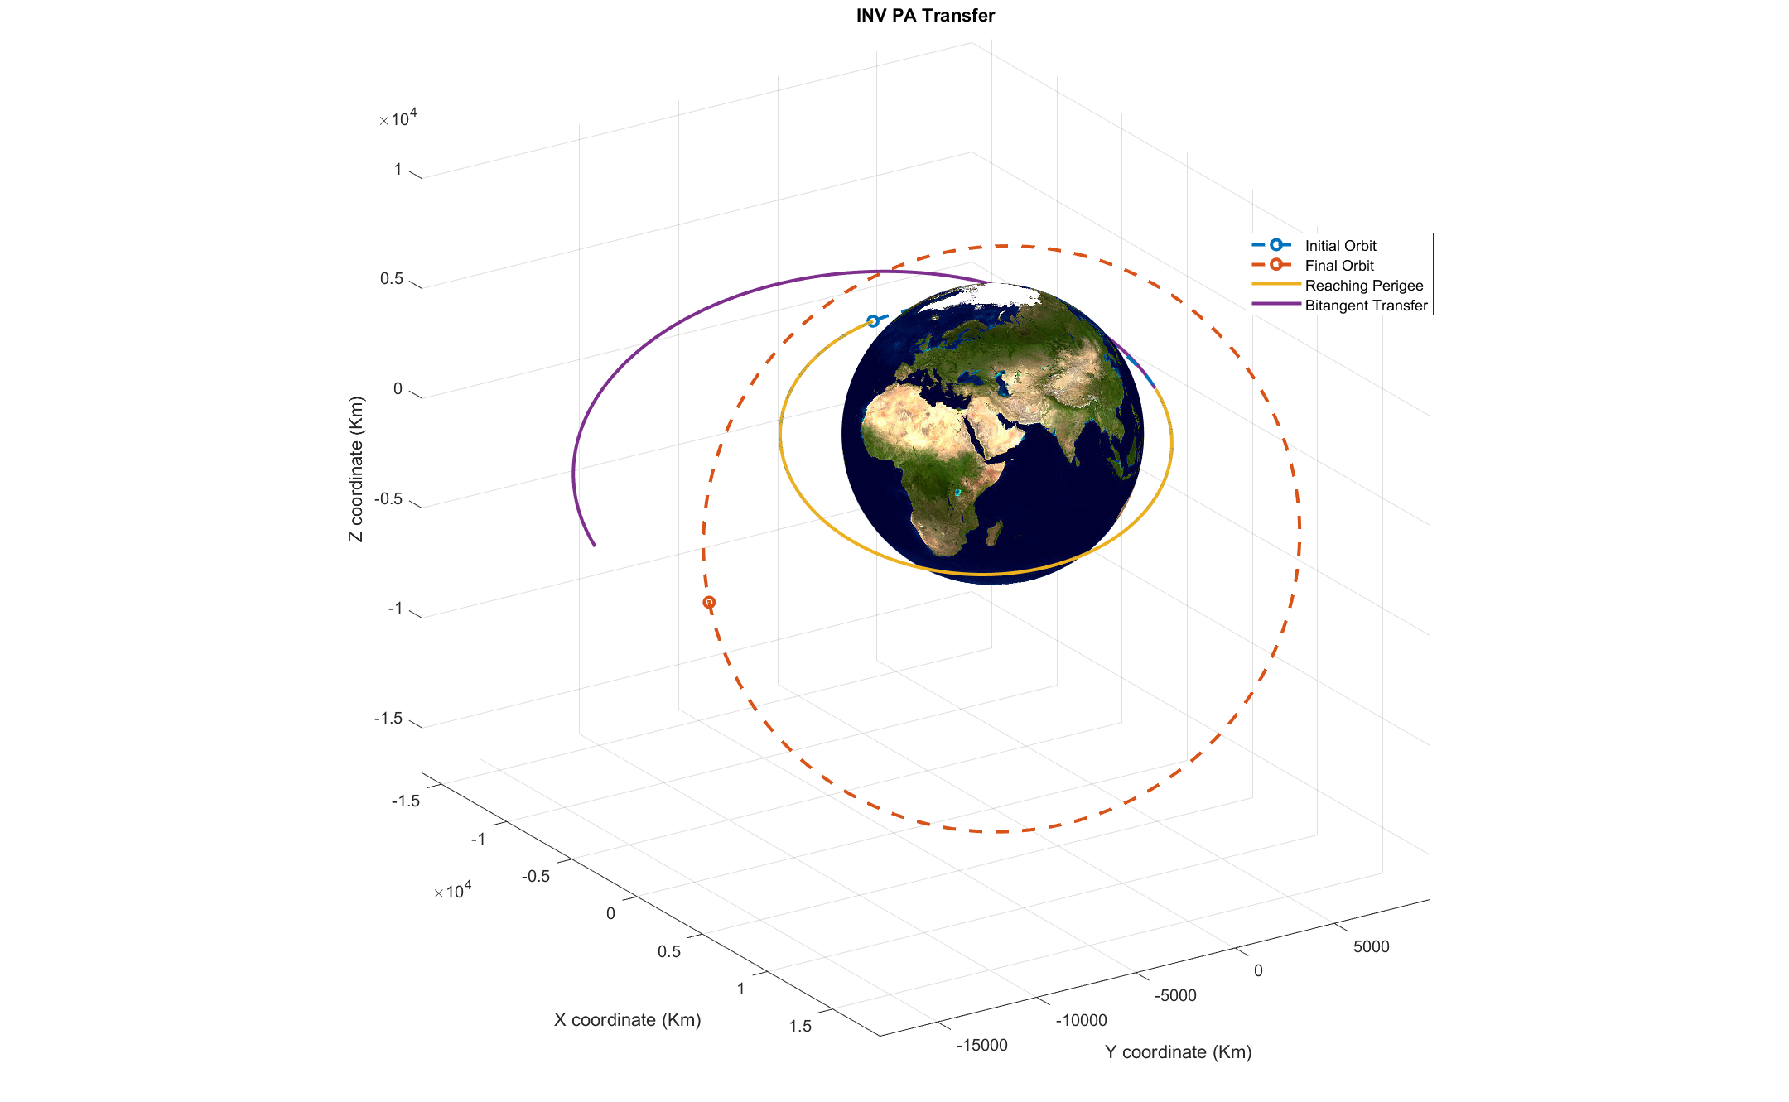
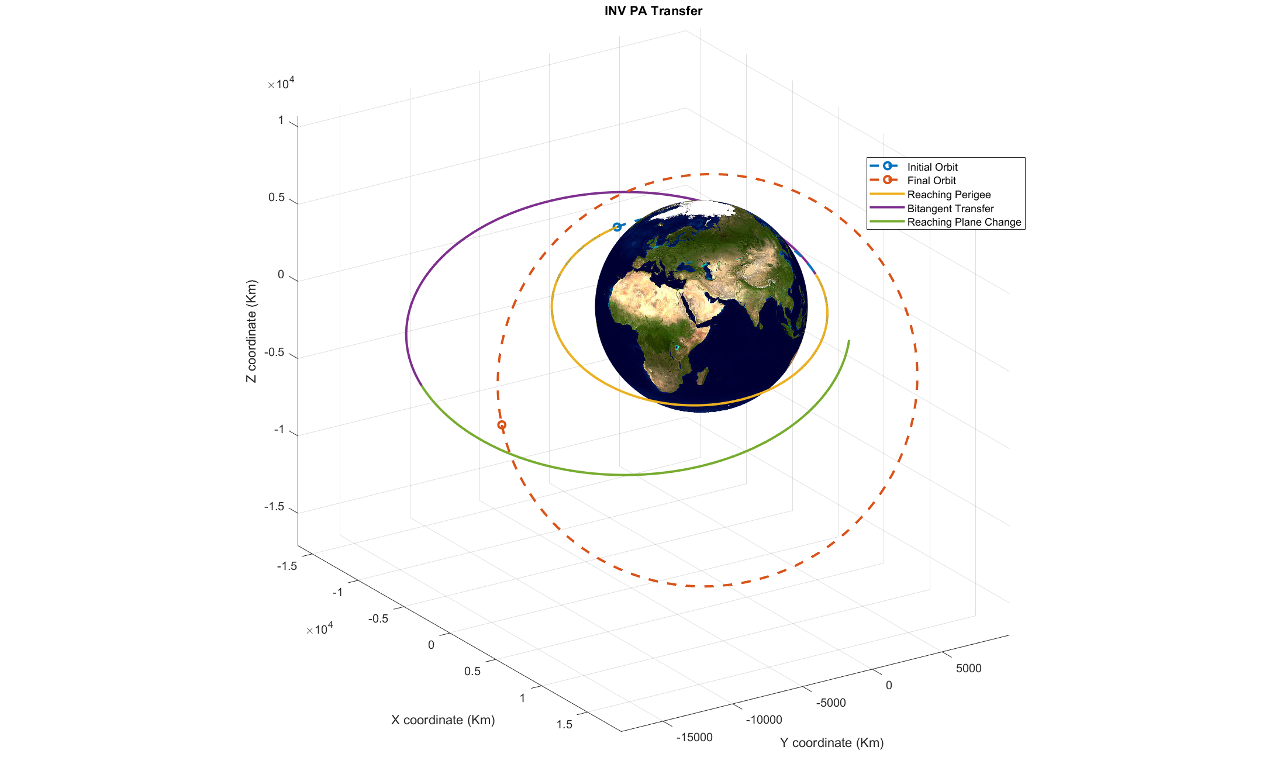
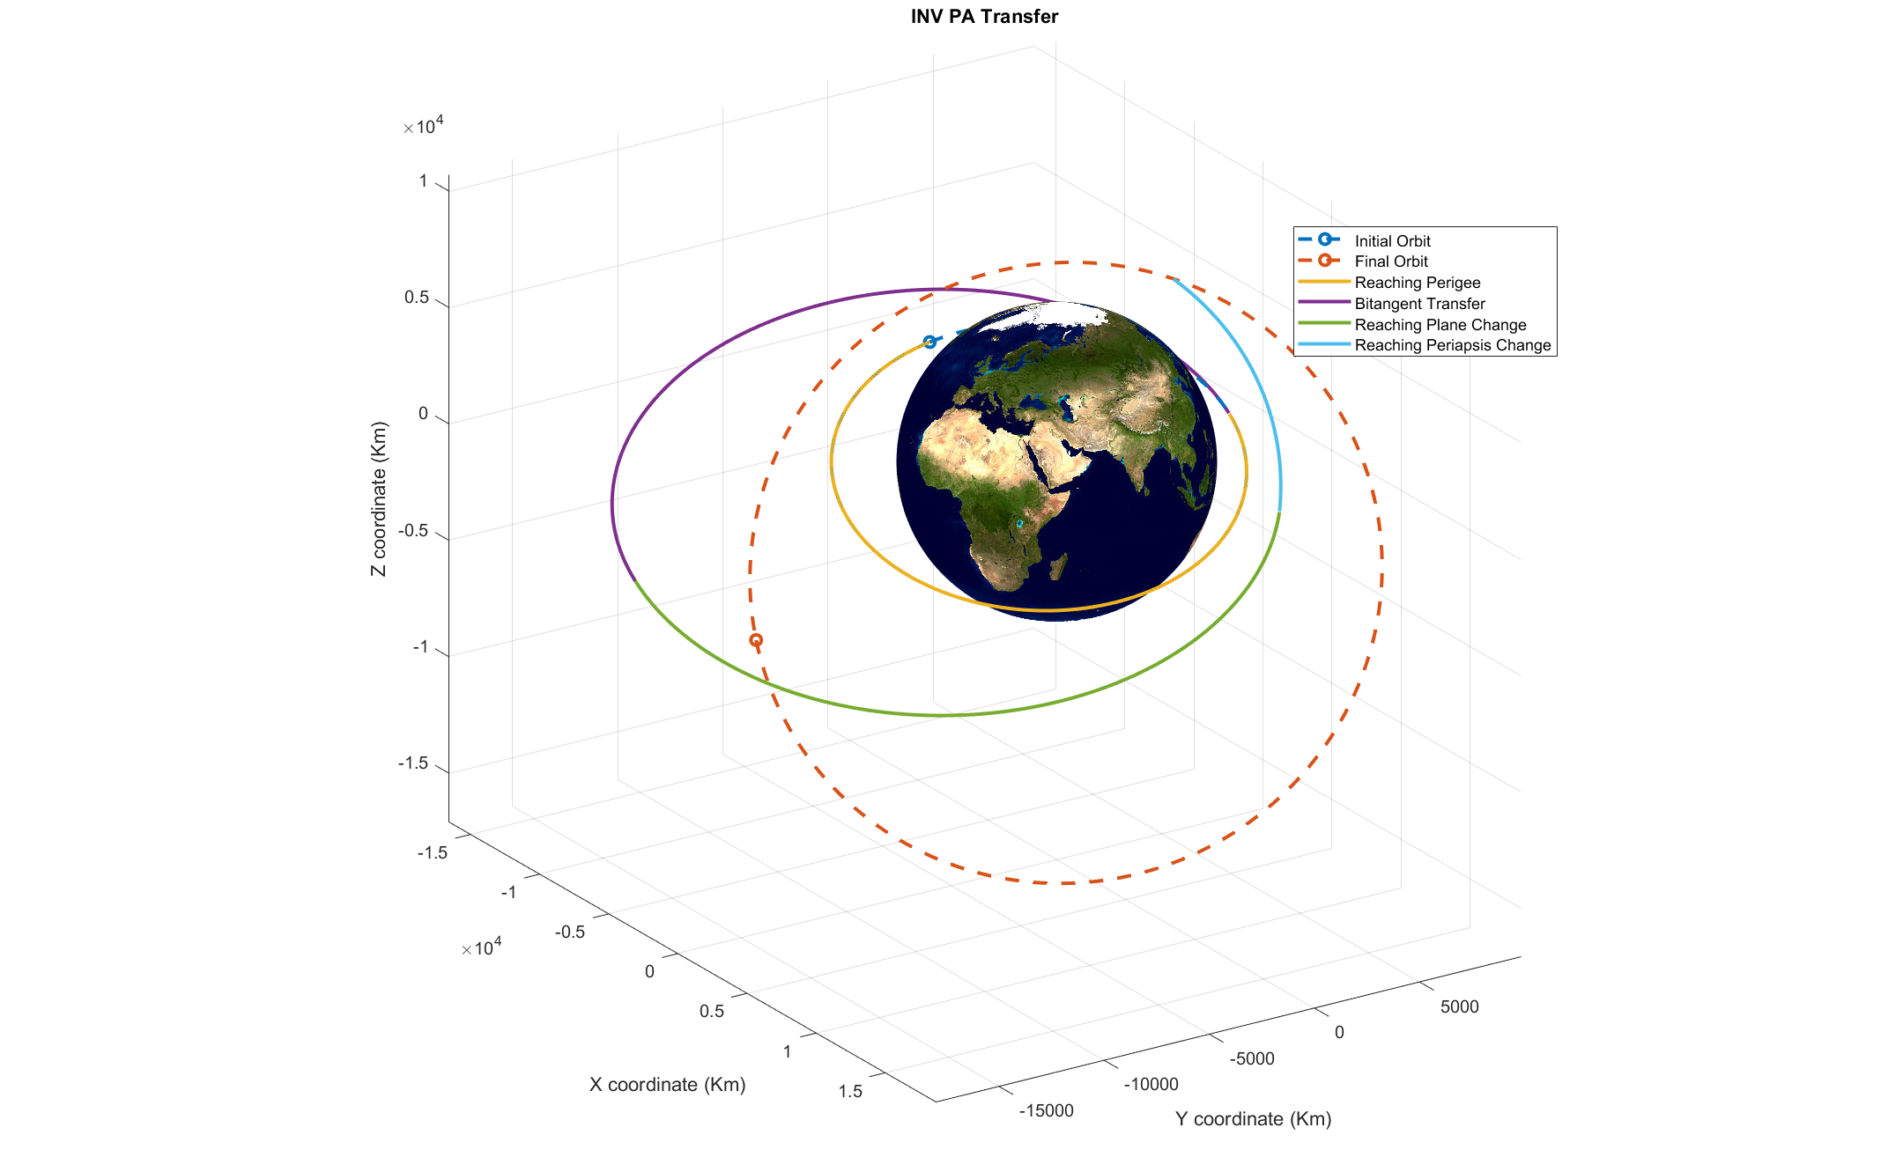
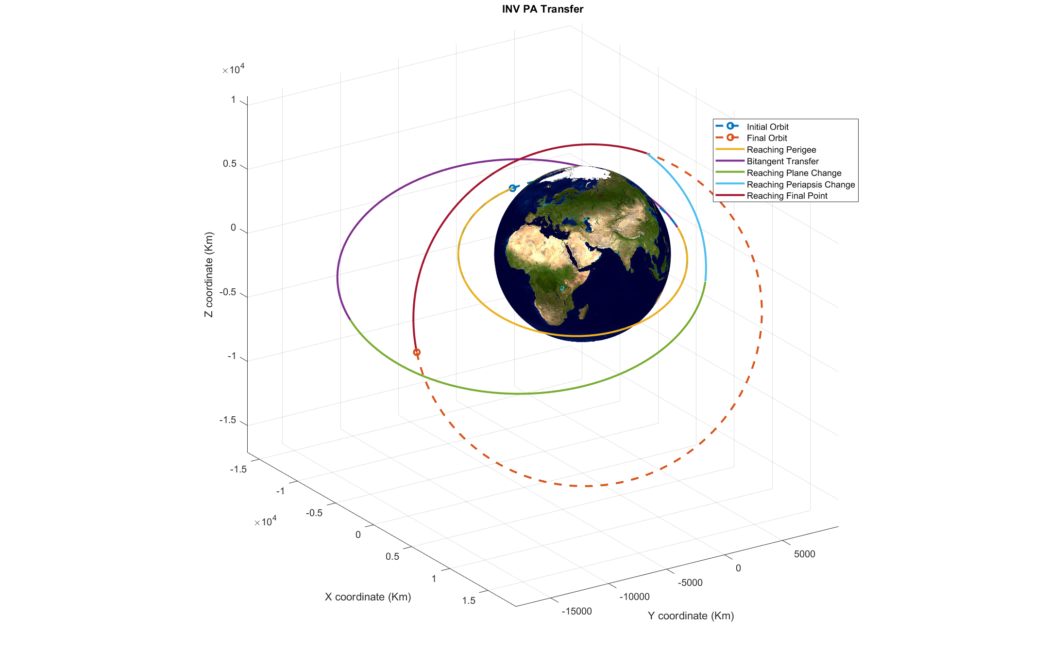
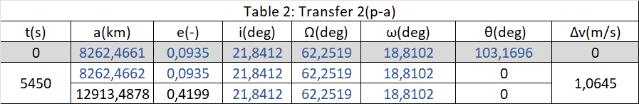
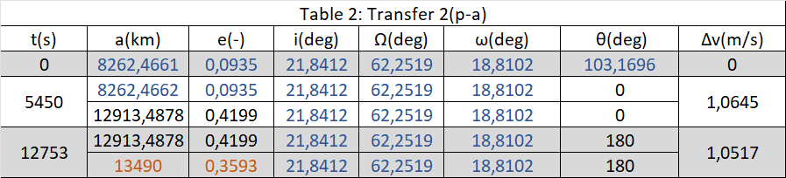
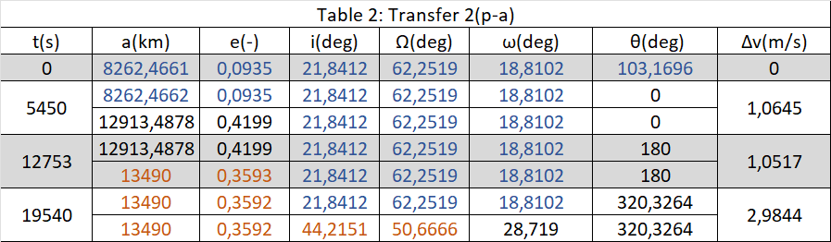
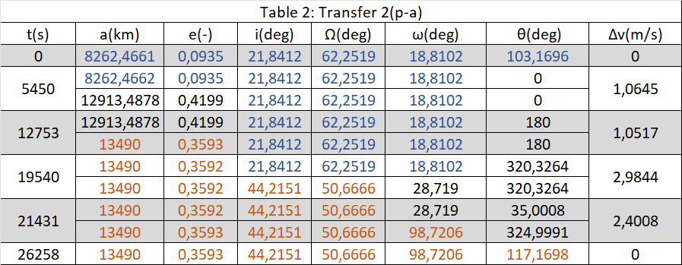
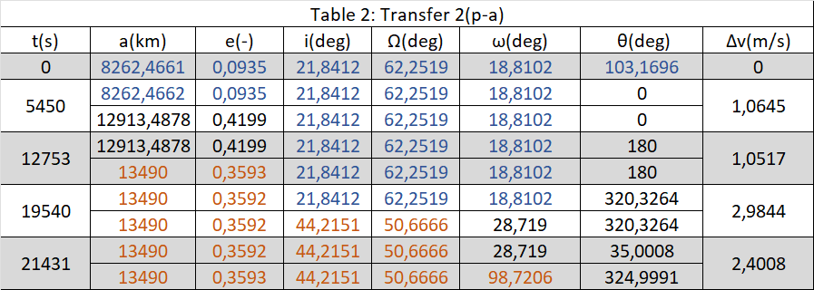
‘Inverse’ strategy: perigee-apogee transfer

Slide 9
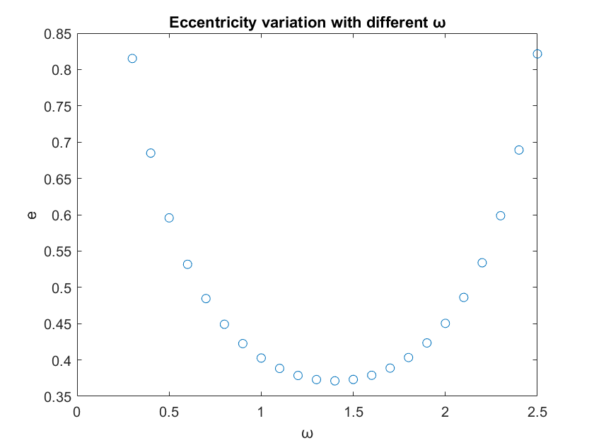
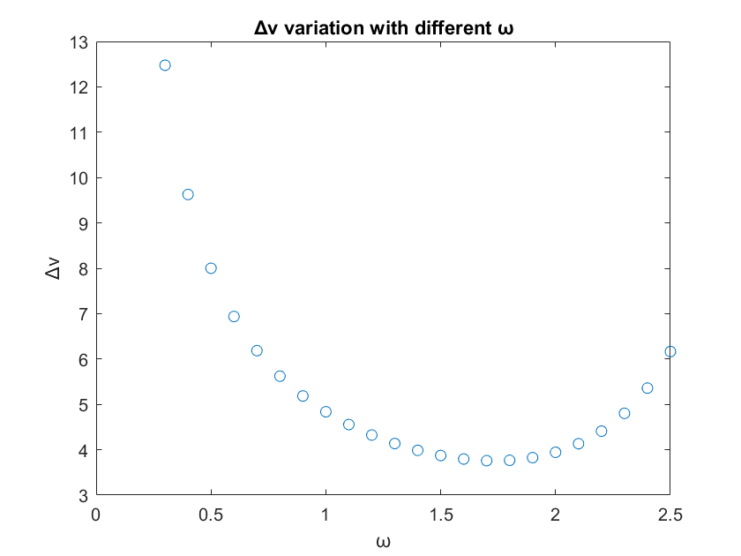
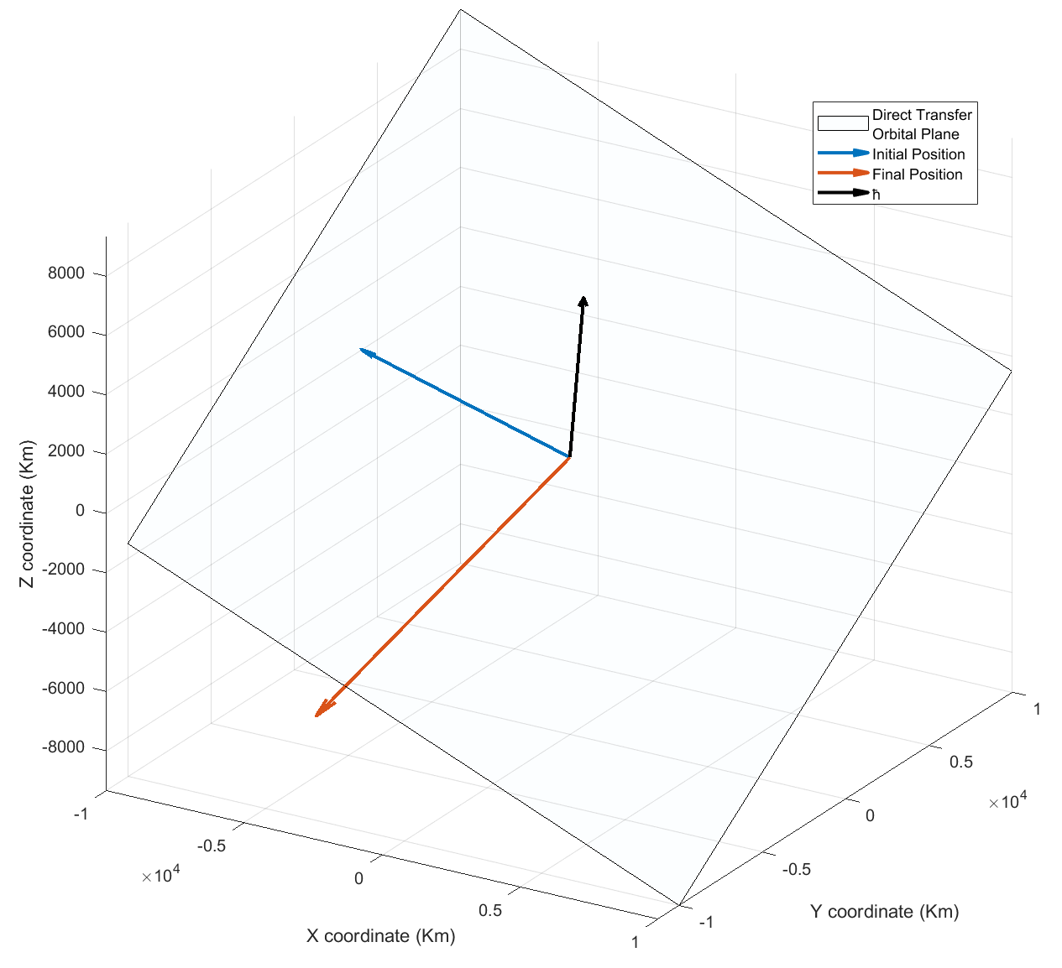
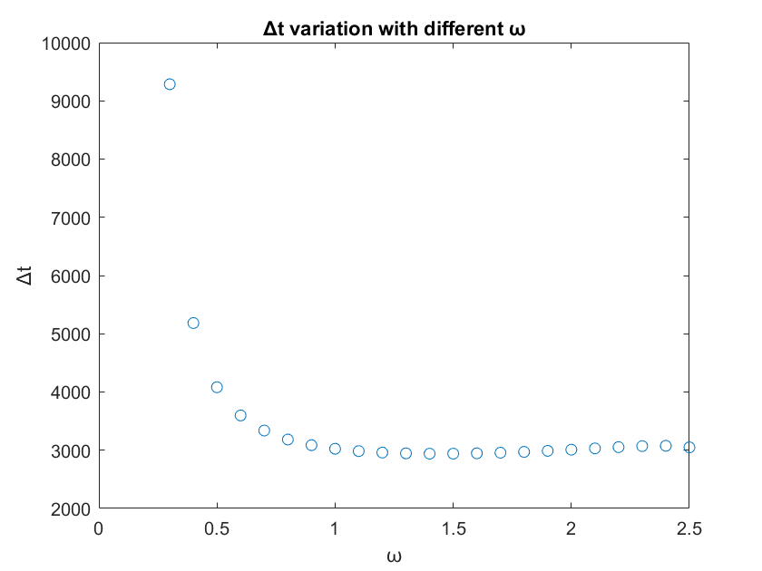
Direct transfer
As we can see the minimum in ∆V required also provides an almost optimal ∆t, this lead us to choose an ω of 1.6 . The selected strategy is better than previous ones both in terms of ∆t = 2947s and ∆V = 3.7962Km/s.
Observing the initial and final points it’s obvious how close they are, so we opted for a direct strategy: moving the S/C on a completely different cofocal orbit applying 2 impulses, one at the starting point and a second one at the final point
Since there isn’t a unique orbit, we can span ω values between 0 and 2π to explore different possibilities.
We can see how some values of ω give us unreasonable results for e and a so we chose to cut them off, and then evaluate the ∆V and ∆t to find the optimal ω.

Slide 10
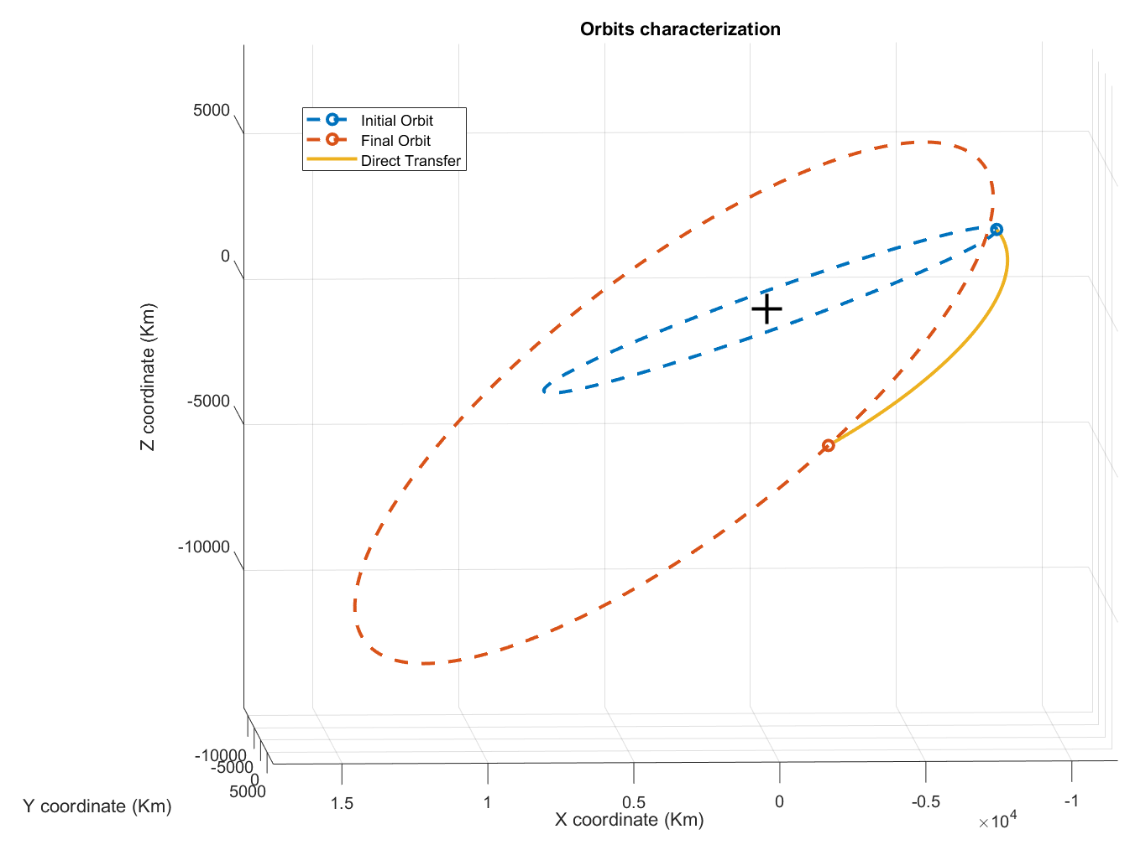
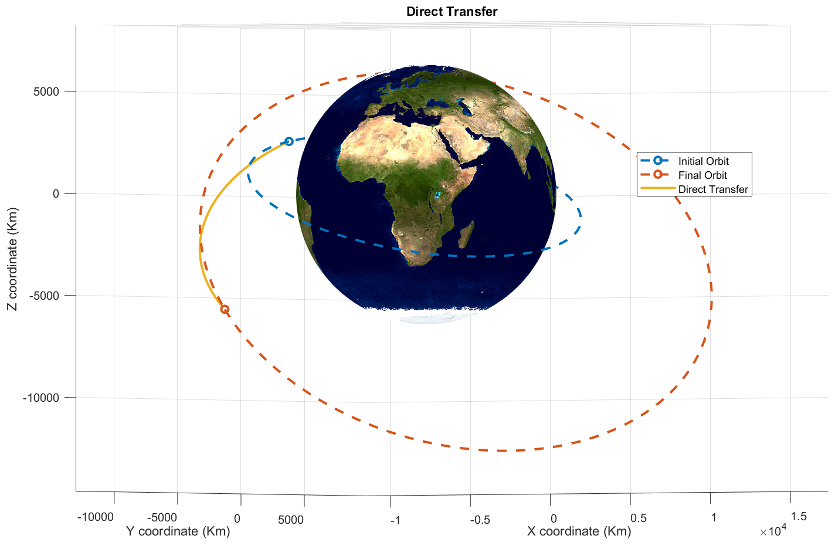
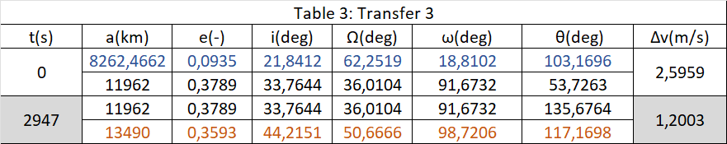
Direct transfer

Slide 11
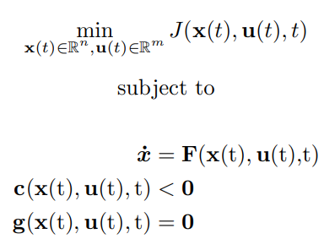
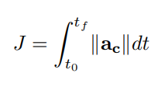
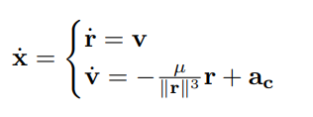
Continuous thrust orbit transfer: theory
Given a certain dynamical system
F(x(t), u(t),t)
we look for an input function u which minimizes a certain objective function
The most general formulation of an optimal control problem is:
The next step is choosing our objective function that will need to be minimized, the obvious choice is the maneuver’s ∆V , which will be calculated as:
There are different approaches to solving this kind of problem: we chose to use a direct method, which consists in using a discrete approximation of the optimal control problem and solving a NLP problem
We will first start by defining our system dynamics, using the classic two body problem equations and x = (r, v) as our state variable and u = ac as our control variable:

Slide 12
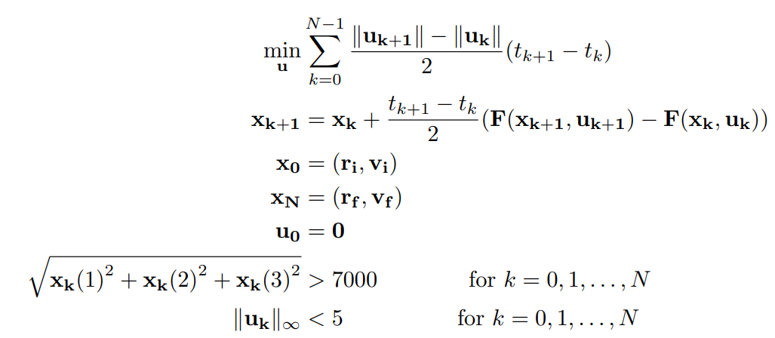
Continuous thrust orbit transfer: defining the problem
The direct method chosen requires discretizing our problem, we use a trapezoidal method to integrate the system dynamic and the objective function.
Here the time discretization that give us the final definition of our problem:

Slide 13
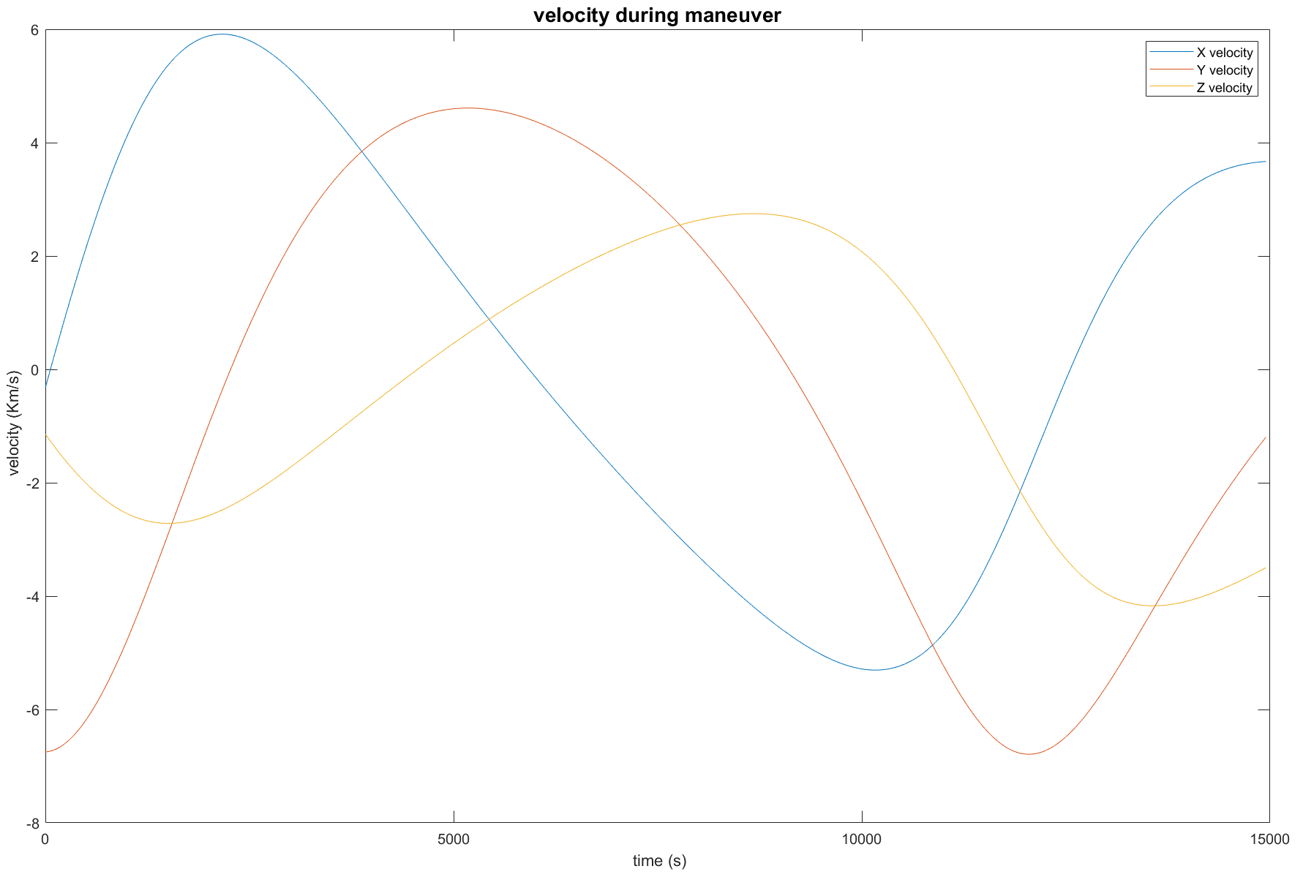
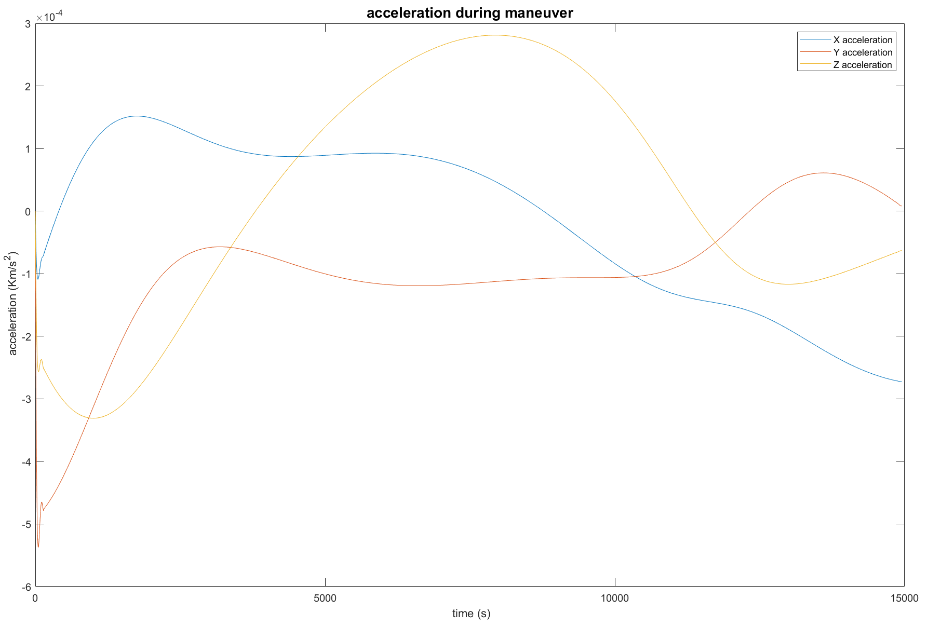

Continuous thrust orbit transfer: maneuver characteristics

Slide 14

Continuous thrust orbit transfer: orbit showcase
The continuous maneuver is optimal for non-impulsive engines that grant low thrust (as Solar sails or electro-magnetic propulsors)

Slide 15

Firma convenzione Politecnico di Milano e Veneranda Fabbrica del Duomo di Milano
Conclusions
In conclusion we opt for the direct transfer: given our starting and finishing conditions it is the best transfer both cost-wise and time-wise
Aula Magna – Rettorato
Mercoledì 27 maggio 2015

